Slide 1



RowHammer and Beyond
Onur Mutlu
omutlu@gmail.com
https://people.inf.ethz.ch/omutlu
4 April 2019
COSADE Keynote Talk

Slide 2
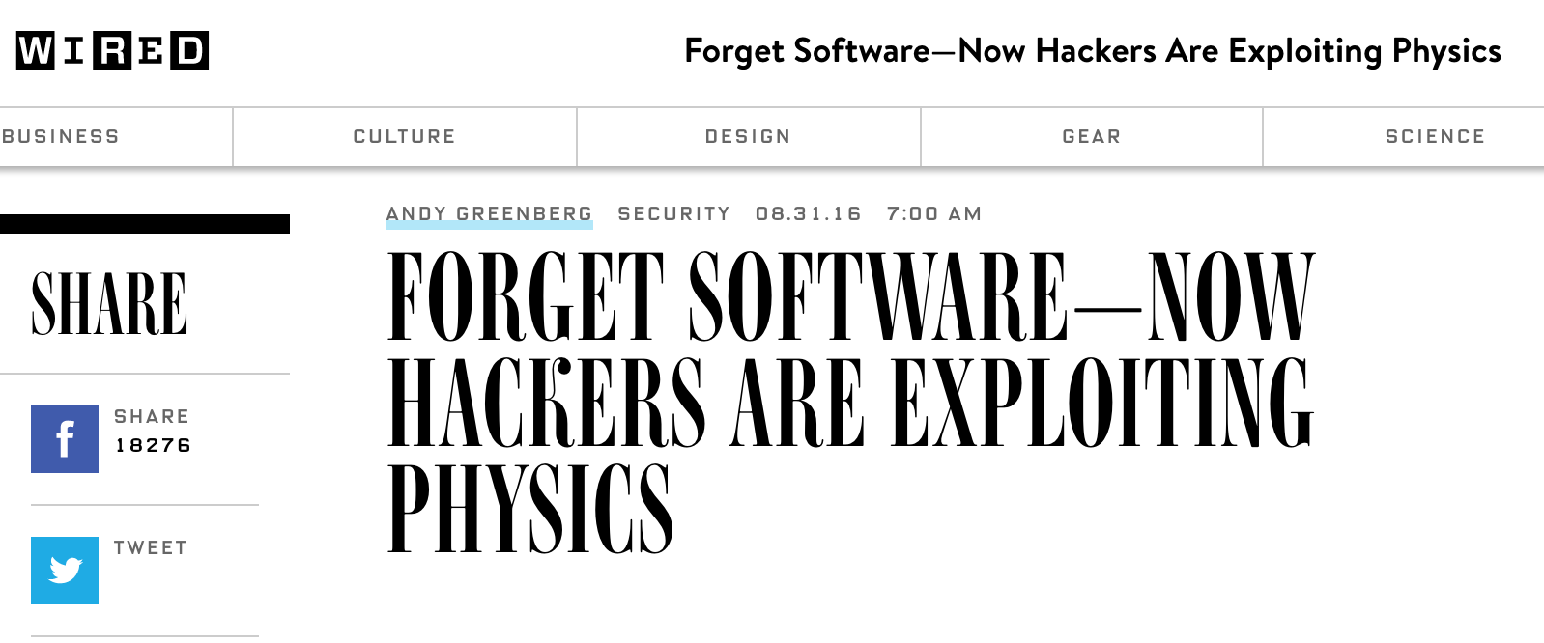
The Story of RowHammer
One can predictably induce bit flips in commodity DRAM chips
  >80% of the tested DRAM chips are vulnerable
First example of how a simple hardware failure mechanism can create a widespread system security vulnerability

Slide 3
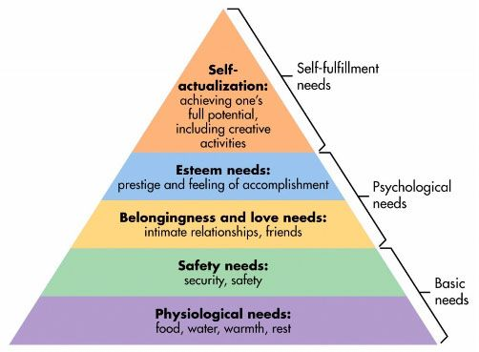

Maslow’s (Human) Hierarchy of Needs
Maslow, “A Theory of Human Motivation,”
Psychological Review, 1943.
Maslow, “A Theory of Human Motivation,”
Psychological Review, 1943.
Maslow, “Motivation and Personality,”
Book, 1954-1970.
We need to start with reliability and security…
Source: https://www.simplypsychology.org/maslow.html
Source: By User:Factoryjoe - Mazlow's Hierarchy of Needs.svg, CC BY-SA 3.0, https://commons.wikimedia.org/w/index.php?curid=7964065

Slide 4
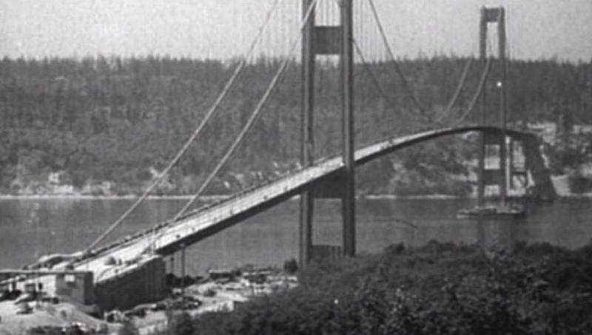
How Reliable/Secure/Safe is This Bridge?
Source: http://www.technologystudent.com/struct1/tacom1.png

Slide 5
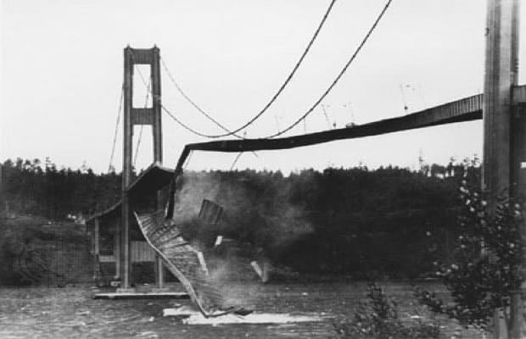
Collapse of the “Galloping Gertie”
Source: AP
http://www.wsdot.wa.gov/tnbhistory/connections/connections3.htm

Slide 6

How Secure Are These People?
Security is about preventing unforeseen consequences
Source: https://s-media-cache-ak0.pinimg.com/originals/48/09/54/4809543a9c7700246a0cf8acdae27abf.jpg

Slide 7
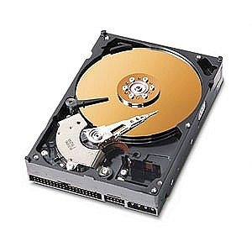
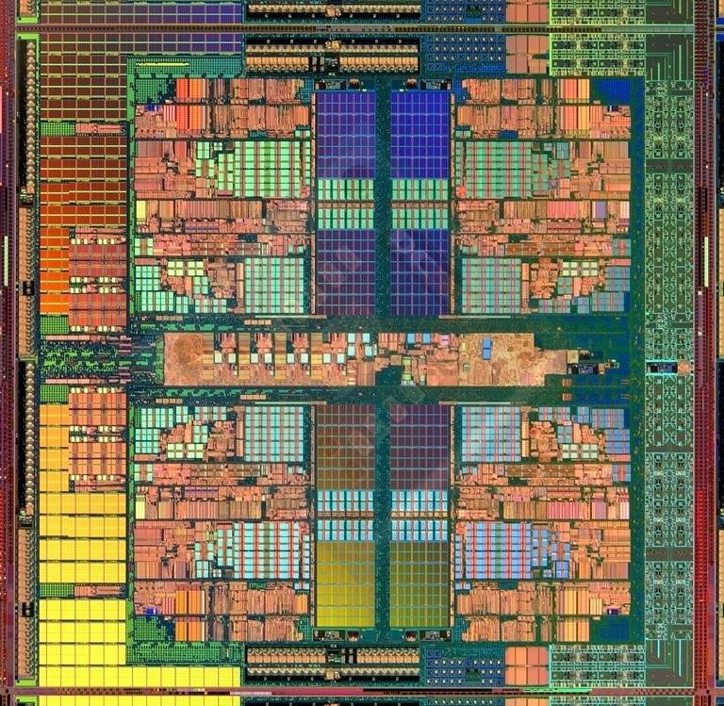
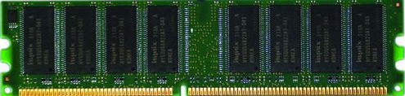
The Main Memory System
Main memory is a critical component of all computing systems: server, mobile, embedded, desktop, sensor
Main memory system must scale (in size, technology, efficiency, cost, and management algorithms) to maintain performance growth and technology scaling benefits
Processors
and caches
Main Memory
Storage (SSD/HDD)

Slide 8
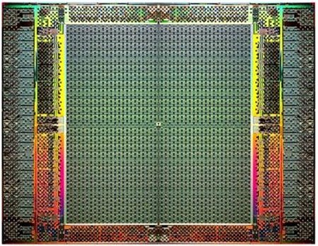
The Main Memory System
Main memory is a critical component of all computing systems: server, mobile, embedded, desktop, sensor
Main memory system must scale (in size, technology, efficiency, cost, and management algorithms) to maintain performance growth and technology scaling benefits
FPGAs
Main Memory
Storage (SSD/HDD)

Slide 9
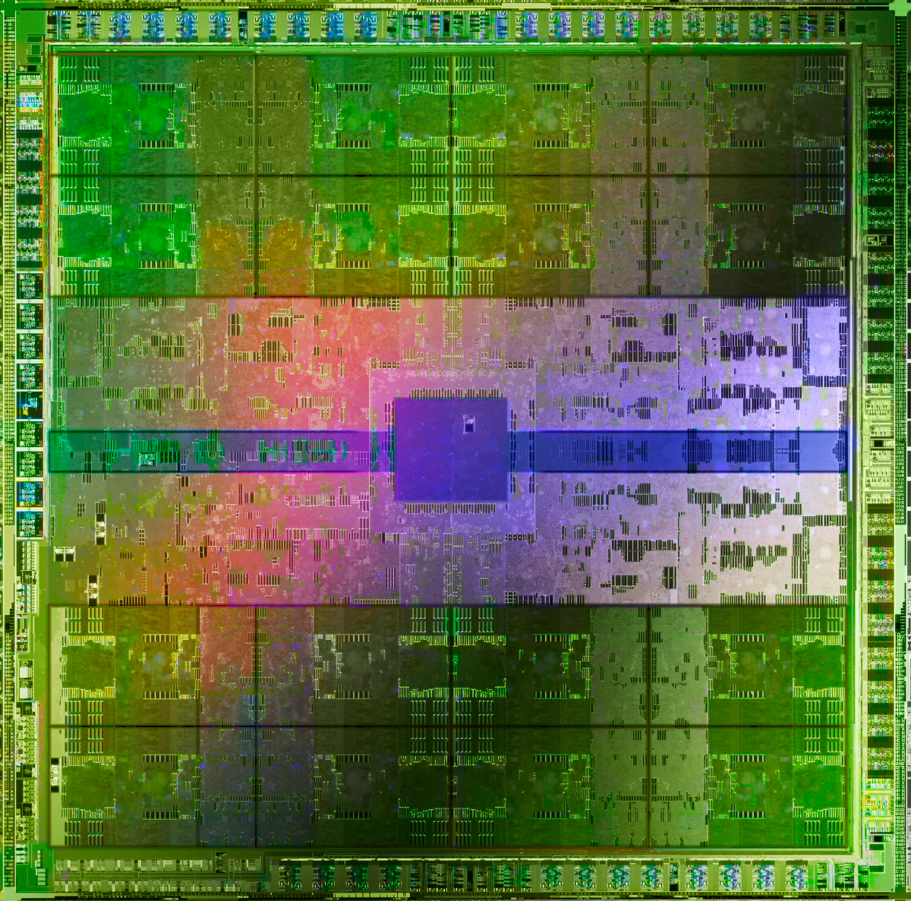
The Main Memory System
Main memory is a critical component of all computing systems: server, mobile, embedded, desktop, sensor
Main memory system must scale (in size, technology, efficiency, cost, and management algorithms) to maintain performance growth and technology scaling benefits
GPUs
Main Memory
Storage (SSD/HDD)

Slide 10
Major Trends Affecting Main Memory (I)
Need for main memory capacity, bandwidth, QoS increasing
Main memory energy/power is a key system design concern
DRAM technology scaling is ending

Slide 11
Major Trends Affecting Main Memory (II)
Need for main memory capacity, bandwidth, QoS increasing
  Multi-core: increasing number of cores/agents
  Data-intensive applications: increasing demand/hunger for data
  Consolidation: cloud computing, GPUs, mobile, heterogeneity
Main memory energy/power is a key system design concern
DRAM technology scaling is ending

Slide 12
DRAM Capacity, Bandwidth, Latency Trends
128x
20x
1.3x

Slide 13
Major Trends Affecting Main Memory (III)
Need for main memory capacity, bandwidth, QoS increasing
Main memory energy/power is a key system design concern
  ~40-50% energy spent in off-chip memory hierarchy [Lefurgy, IEEE Computer’03] >40% power in DRAM [Ware, HPCA’10][Paul,ISCA’15]
  DRAM consumes power even when not used (periodic refresh)
DRAM technology scaling is ending

Slide 14
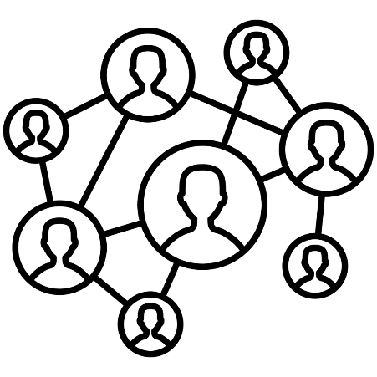

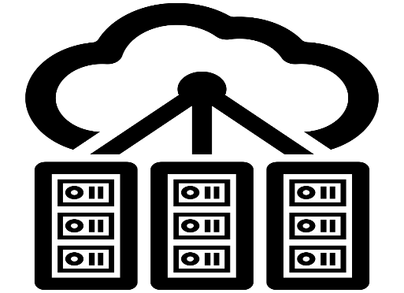

DRAM Is Critical for Performance & Energy
In-memory Databases
[Mao+, EuroSys’12;
Clapp+ (Intel), IISWC’15]
Graph/Tree Processing
[Xu+, IISWC’12; Umuroglu+, FPL’15]
In-Memory Data Analytics
[Clapp+ (Intel), IISWC’15;
Awan+, BDCloud’15]
Datacenter Workloads
[Kanev+ (Google), ISCA’15]

Slide 15
DRAM Is Critical for Performance & Energy
In-memory Databases
[Mao+, EuroSys’12;
Clapp+ (Intel), IISWC’15]
Graph/Tree Processing
[Xu+, IISWC’12; Umuroglu+, FPL’15]
Memory → performance & energy bottleneck
In-Memory Data Analytics
[Clapp+ (Intel), IISWC’15;
Awan+, BDCloud’15]
Datacenter Workloads
[Kanev+ (Google), ISCA’15]

Slide 16





DRAM Is Critical for Performance & Energy
  Chrome
TensorFlow Mobile
    Google’s web browser
Google’s machine learning framework
  Video Playback
  Video Capture
Google’s video codec
Google’s video codec
Notes:
In this work, we take a look at widely-used google consumer workloads, to figure out the major sources of energy consumption.
We look at Google Chrome web brower. We take a look at Tensorflow, Google’s machine learning framework, and we also take a look at two important video related workloads, video playback and video capture, both rely on Google’s vp9 codec technology.

Slide 17
DRAM Is Critical for Performance & Energy
  Chrome
TensorFlow Mobile
    Google’s web browser
Google’s machine learning framework
Memory → performance & energy bottleneck
  Video Playback
  Video Capture
Google’s video codec
Google’s video codec
Notes:
In this work, we take a look at widely-used google consumer workloads, to figure out the major sources of energy consumption.
We look at Google Chrome web brower. We take a look at Tensorflow, Google’s machine learning framework, and we also take a look at two important video related workloads, video playback and video capture, both rely on Google’s vp9 codec technology.

Slide 18
DRAM Is Critical for Performance & Energy
Amirali Boroumand, Saugata Ghose, Youngsok Kim, Rachata Ausavarungnirun, Eric Shiu, Rahul Thakur, Daehyun Kim, Aki Kuusela, Allan Knies, Parthasarathy Ranganathan, and Onur Mutlu,
"Google Workloads for Consumer Devices: Mitigating Data Movement Bottlenecks"
Proceedings of the 23rd International Conference on Architectural Support for Programming Languages and Operating Systems (ASPLOS), Williamsburg, VA, USA, March 2018.
62.7% of the total system energy
is spent on data movement

Slide 19
Major Trends Affecting Main Memory (IV)
Need for main memory capacity, bandwidth, QoS increasing
Main memory energy/power is a key system design concern
DRAM technology scaling is ending
  ITRS projects DRAM will not scale easily below X nm
  Scaling has provided many benefits:
    higher capacity (density), lower cost, lower energy

Slide 20
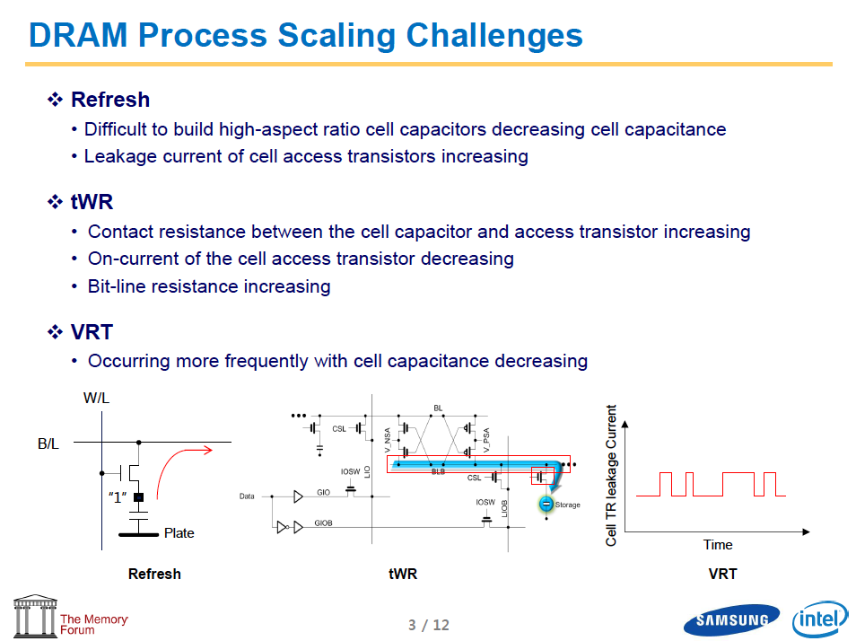
Industry Is Writing Papers About It, Too

Slide 21
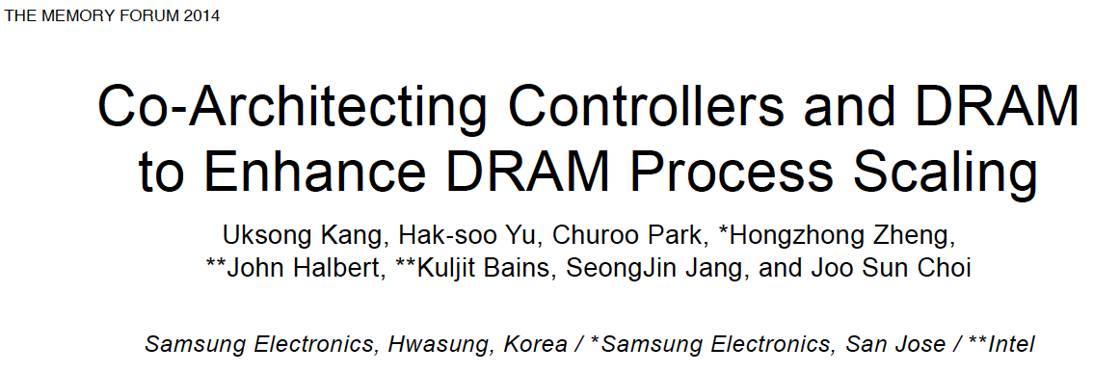
Industry Is Writing Papers About It, Too

Slide 22
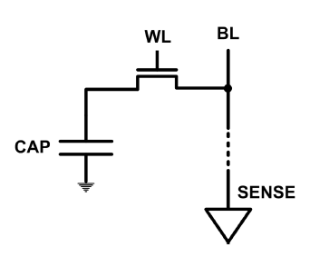
The DRAM Scaling Problem
DRAM stores charge in a capacitor (charge-based memory)
  Capacitor must be large enough for reliable sensing
  Access transistor should be large enough for low leakage and high retention time
  Scaling beyond 40-35nm (2013) is challenging [ITRS, 2009]
DRAM capacity, cost, and energy/power hard to scale

Slide 23
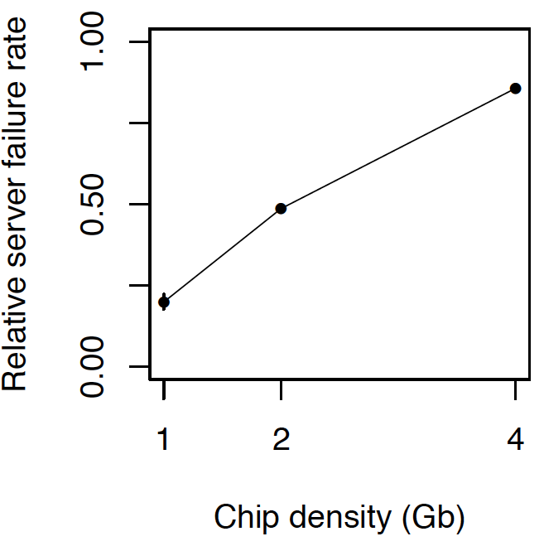
As Memory Scales, It Becomes Unreliable
Data from all of Facebook’s servers worldwide
Meza+, “Revisiting Memory Errors in Large-Scale Production Data Centers,” DSN’15.
Intuition:
quadratic
increase in
capacity

Slide 24
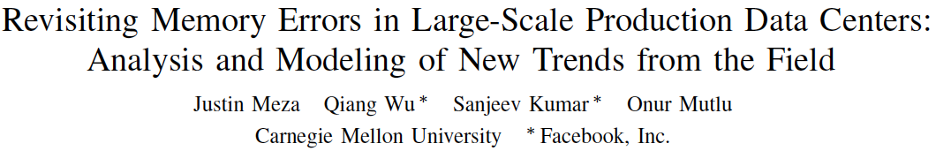
Large-Scale Failure Analysis of DRAM Chips
Analysis and modeling of memory errors found in all of Facebook’s server fleet
Justin Meza, Qiang Wu, Sanjeev Kumar, and Onur Mutlu,
"Revisiting Memory Errors in Large-Scale Production Data Centers: Analysis and Modeling of New Trends from the Field"
Proceedings of the 45th Annual IEEE/IFIP International Conference on Dependable Systems and Networks (DSN), Rio de Janeiro, Brazil, June 2015.
[Slides (pptx) (pdf)] [DRAM Error Model]

Slide 25
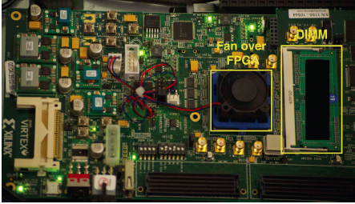
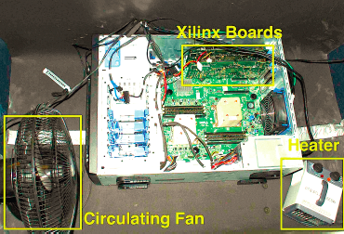
Infrastructures to Understand Such Issues
  An Experimental Study of Data Retention Behavior in Modern DRAM Devices: Implications for Retention Time Profiling Mechanisms (Liu et al., ISCA 2013)
  The Efficacy of Error Mitigation Techniques for DRAM Retention Failures: A Comparative Experimental Study
  (Khan et al., SIGMETRICS 2014)
  Flipping Bits in Memory Without Accessing Them: An Experimental Study of DRAM Disturbance Errors (Kim et al., ISCA 2014)
  Adaptive-Latency DRAM: Optimizing DRAM Timing for the Common-Case (Lee et al., HPCA 2015)
  AVATAR: A Variable-Retention-Time (VRT) Aware Refresh for DRAM Systems (Qureshi et al., DSN 2015)

Slide 26
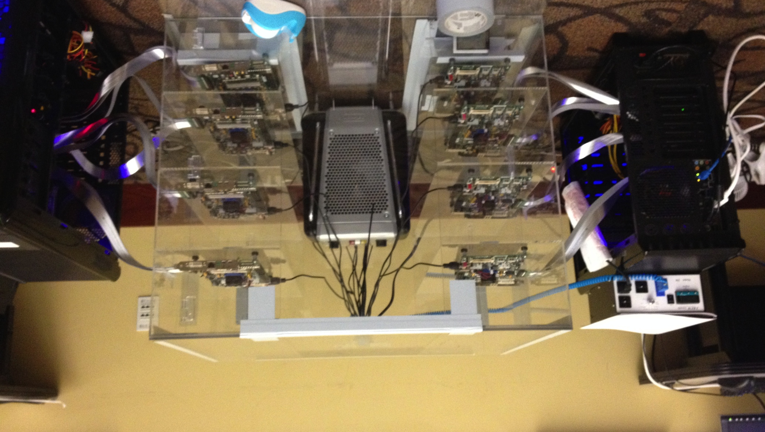
Infrastructures to Understand Such Issues
Temperature
Controller
FPGAs
Heater
FPGAs
PC
  Kim+, “Flipping Bits in Memory Without Accessing Them: An Experimental Study of DRAM Disturbance Errors,” ISCA 2014.

Slide 27
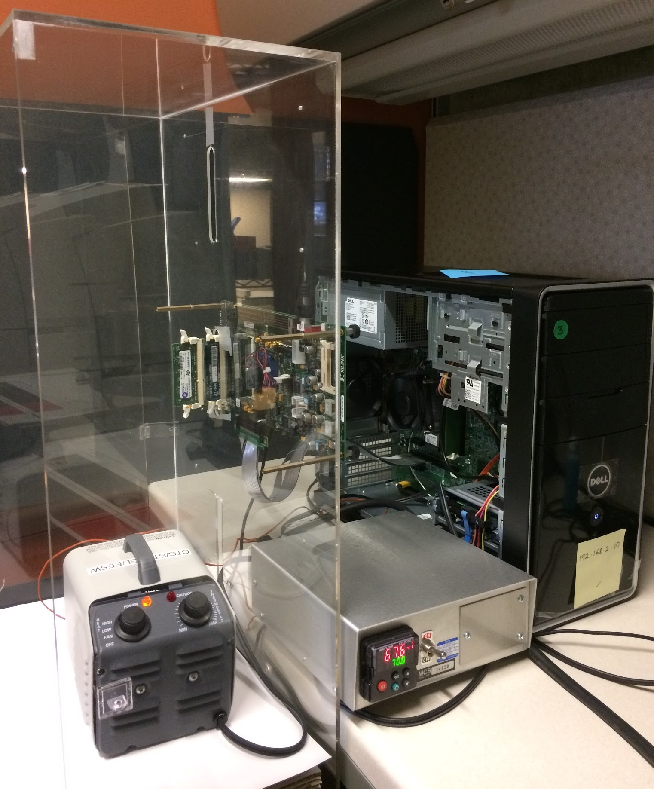
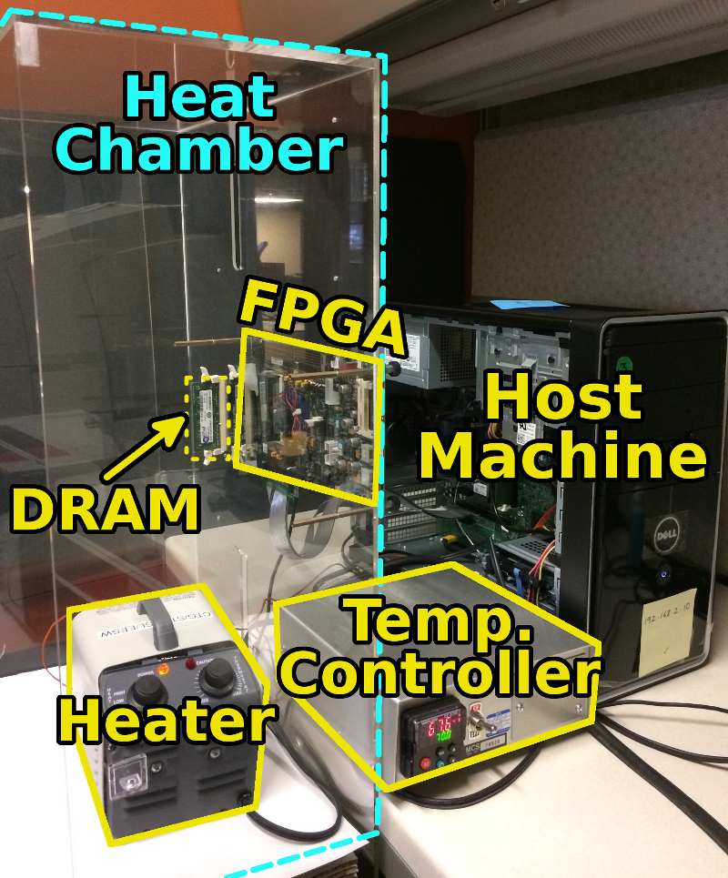
SoftMC: Open Source DRAM Infrastructure
Hasan Hassan et al., “SoftMC: A Flexible and Practical Open-Source Infrastructure for Enabling Experimental DRAM Studies,” HPCA 2017.
Flexible
Easy to Use (C++ API)
Open-source
github.com/CMU-SAFARI/SoftMC

Slide 28
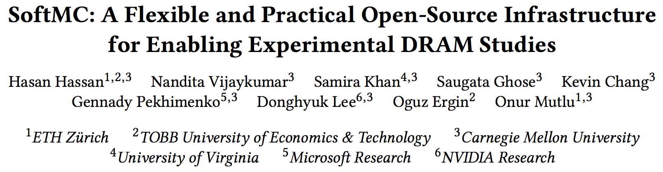
SoftMC: Open Source DRAM Infrastructure
https://github.com/CMU-SAFARI/SoftMC

Slide 29
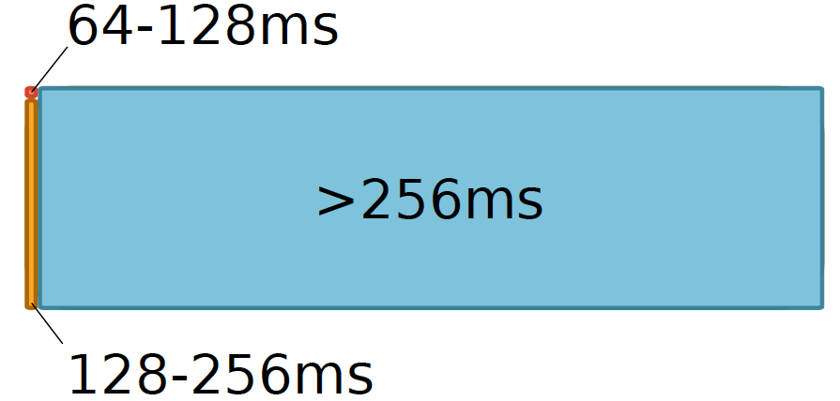
Data Retention in Memory [Liu et al., ISCA 2013]
Retention Time Profile of DRAM looks like this:
Location dependent
Stored value pattern dependent
Time dependent
Liu+, “RAIDR: Retention-Aware Intelligent DRAM Refresh,” ISCA 2012.

Slide 30
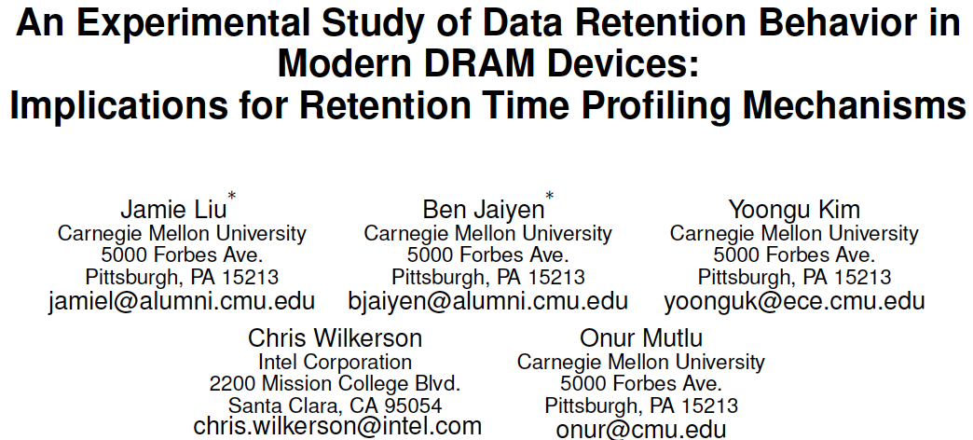
Analysis of Data Retention Failures [ISCA’13]
Jamie Liu, Ben Jaiyen, Yoongu Kim, Chris Wilkerson, and Onur Mutlu,
"An Experimental Study of Data Retention Behavior in Modern DRAM Devices: Implications for Retention Time Profiling Mechanisms"
Proceedings of the 40th International Symposium on Computer Architecture (ISCA), Tel-Aviv, Israel, June 2013. Slides (ppt) Slides (pdf)

Slide 31
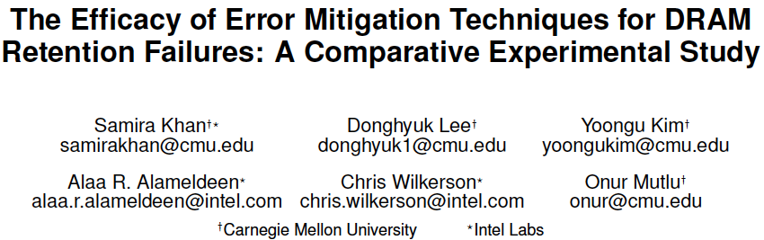
Mitigation of Retention Issues [SIGMETRICS’14]
Samira Khan, Donghyuk Lee, Yoongu Kim, Alaa Alameldeen, Chris Wilkerson, and Onur Mutlu,
"The Efficacy of Error Mitigation Techniques for DRAM Retention Failures: A Comparative Experimental Study"
Proceedings of the ACM International Conference on Measurement and Modeling of Computer Systems (SIGMETRICS), Austin, TX, June 2014. [Slides (pptx) (pdf)] [Poster (pptx) (pdf)] [Full data sets]

Slide 32
A Curious Discovery [Kim et al., ISCA 2014]
One can
predictably induce errors
in most DRAM memory chips

Slide 33
DRAM RowHammer
A simple hardware failure mechanism
can create a widespread
system security vulnerability

Slide 34
Modern DRAM is Prone to Disturbance Errors
Row of Cells
Wordline
Row
Victim Row
Row
Hammered Row
V_{LOW}
Opened
V_{HIGH}
Closed
Row
Victim Row
Row
Repeatedly reading a row enough times (before memory gets refreshed) induces disturbance errors in adjacent rows in most real DRAM chips you can buy today
Flipping Bits in Memory Without Accessing Them: An Experimental Study of DRAM Disturbance Errors, (Kim et al., ISCA 2014)

Slide 35
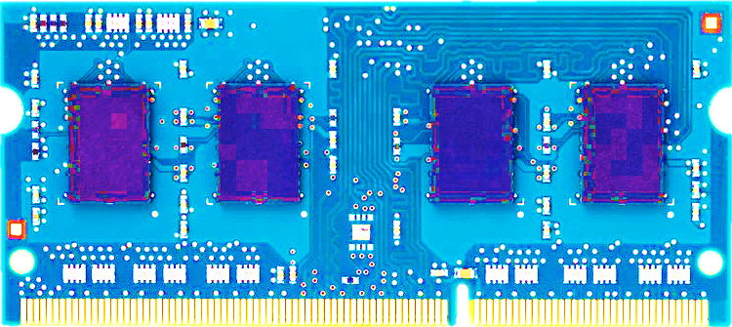
Most DRAM Modules Are Vulnerable
A company
B company
C company
86%
(37/43)
83%
(45/54)
88%
(28/32)
Up to
1.0×10⁷
errors
Up to
2.7×10⁶
errors
Up to
3.3×10⁵
errors
Flipping Bits in Memory Without Accessing Them: An Experimental Study of DRAM Disturbance Errors, (Kim et al., ISCA 2014)

Slide 36
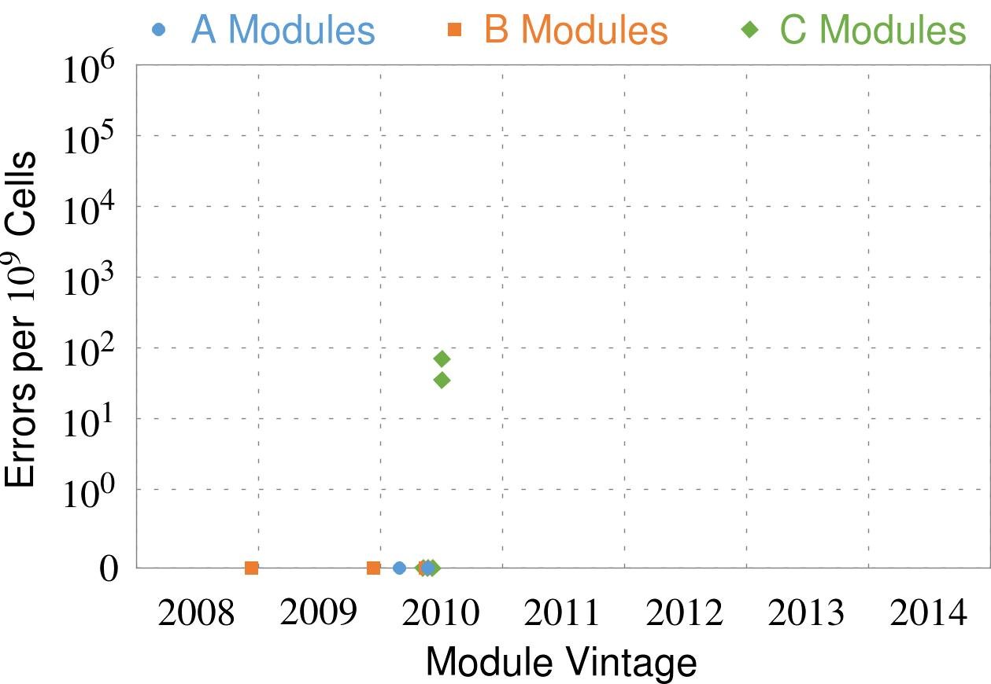
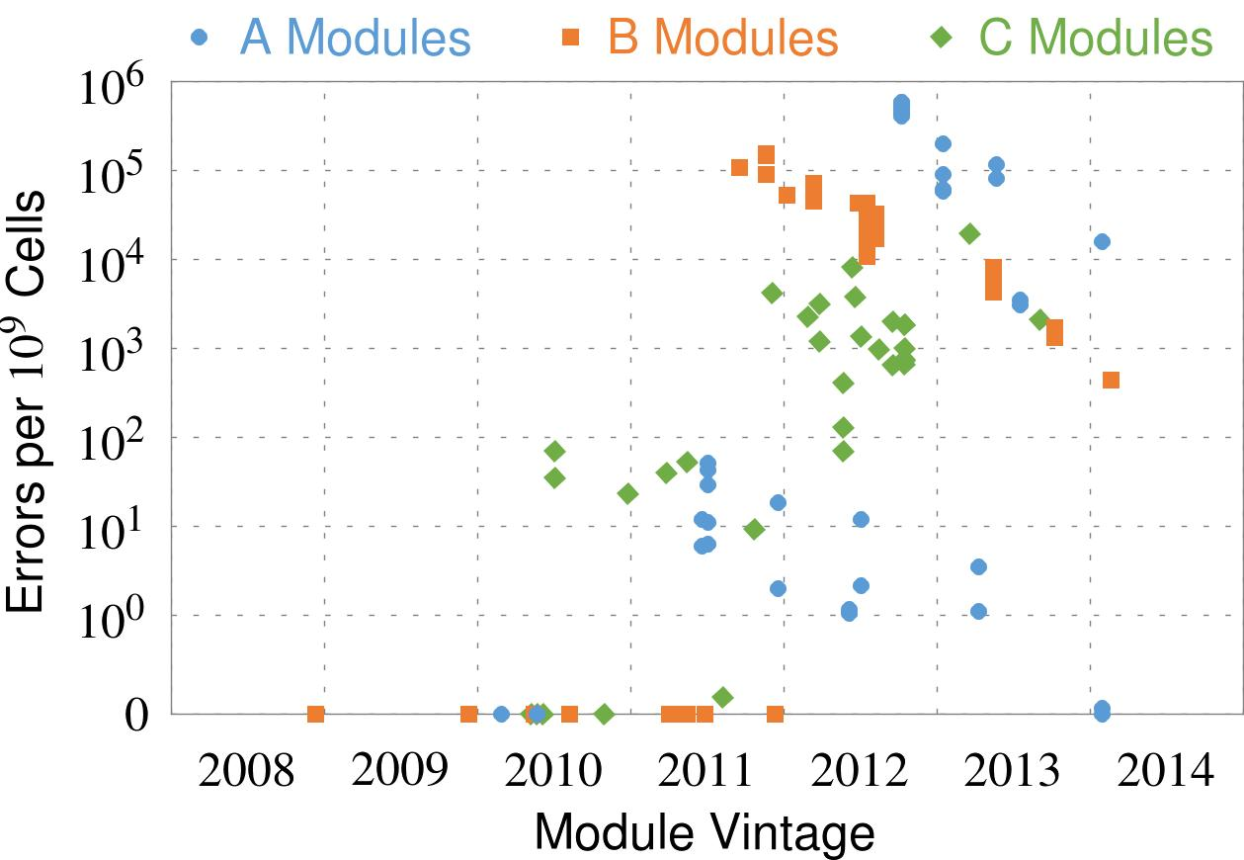
Recent DRAM Is More Vulnerable
Notes:
In this figure, the x-axis is the module manufacture date. And the y-axis is the number of errors in a module, normalized to one billion cells. In 2008 and 2009, there are no errors. But, in 2010, we first start to see errors in C modules. After 2010, the errors start to proliferate. For A and B modules, we first start to see errors in 2011. In particular, all modules from 2012 and 2013 are vulnerable.

Slide 37
Recent DRAM Is More Vulnerable
First
Appearance
Notes:
In this figure, the x-axis is the module manufacture date. And the y-axis is the number of errors in a module, normalized to one billion cells. In 2008 and 2009, there are no errors. But, in 2010, we first start to see errors in C modules. After 2010, the errors start to proliferate. For A and B modules, we first start to see errors in 2011. In particular, all modules from 2012 and 2013 are vulnerable.

Slide 38
Recent DRAM Is More Vulnerable
First
Appearance
All modules from 2012–2013 are vulnerable
Notes:
In this figure, the x-axis is the module manufacture date. And the y-axis is the number of errors in a module, normalized to one billion cells. In 2008 and 2009, there are no errors. But, in 2010, we first start to see errors in C modules. After 2010, the errors start to proliferate. For A and B modules, we first start to see errors in 2011. In particular, all modules from 2012 and 2013 are vulnerable.

Slide 39
Why Is This Happening?
DRAM cells are too close to each other!
  They are not electrically isolated from each other
Access to one cell affects the value in nearby cells
  due to electrical interference between
    the cells
    wires used for accessing the cells
  Also called cell-to-cell coupling/interference
Example: When we activate (apply high voltage) to a row, an adjacent row gets slightly activated as well
  Vulnerable cells in that slightly-activated row lose a little bit of charge
  If row hammer happens enough times, charge in such cells gets drained

Slide 40
Higher-Level Implications
This simple circuit level failure mechanism has enormous implications on upper layers of the transformation hierarchy
Problem
Problem
Algorithm
Algorithm
Program/Language
User
Program/Language
Runtime System
(VM, OS, MM)
Runtime System
(VM, OS, MM)
ISA (Architecture)
ISA
Microarchitecture
Microarchitecture
Logic
Logic
Devices
Devices
Electrons
Electrons

Slide 41
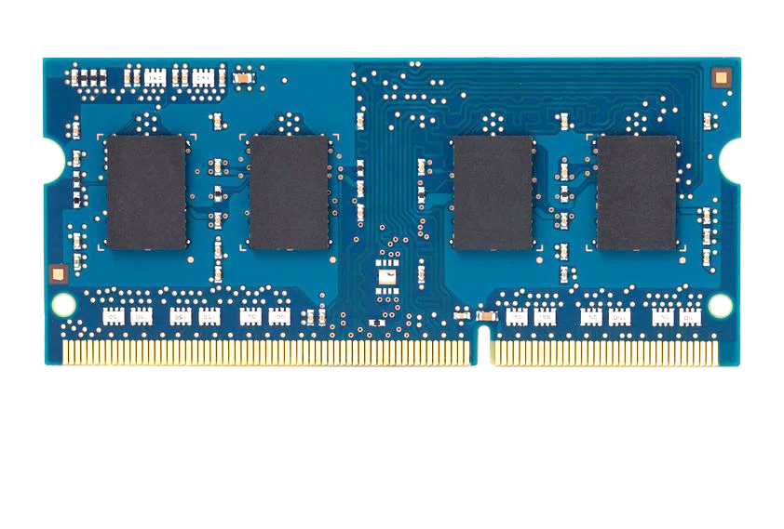
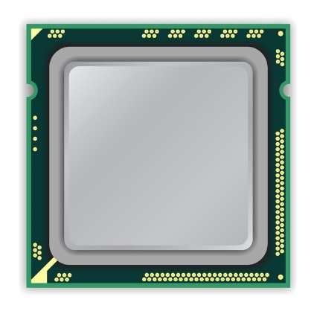
A Simple Program Can Induce Many Errors
CPU
DRAM Module
loop:
mov (X), %eax
mov (Y), %ebx
clflush (X)
clflush (Y)
mfence
jmp loop
X
Y
  Download from: https://github.com/CMU-SAFARI/rowhammer
Notes:
We demonstrate the errors on multiple x86 systems. Shown to the bottom-left is a “disturbance kernel”. When executed, it forces two rows to be opened and closed one after the other – over and over again. Consequently, it induces many errors in the module.

Slide 42
A Simple Program Can Induce Many Errors
CPU
DRAM Module
Avoid cache hits
  Flush X from cache
Avoid row hits to X
  Read Y in another row
X
Y
  Download from: https://github.com/CMU-SAFARI/rowhammer
Notes:
We demonstrate the errors on multiple x86 systems. Shown to the bottom-left is a “disturbance kernel”. When executed, it forces two rows to be opened and closed one after the other – over and over again. Consequently, it induces many errors in the module.

Slide 43
A Simple Program Can Induce Many Errors
CPU
DRAM Module
loop:
mov (X), %eax
mov (Y), %ebx
clflush (X)
clflush (Y)
mfence
jmp loop
X
Y
  Download from: https://github.com/CMU-SAFARI/rowhammer
Notes:
We demonstrate the errors on multiple x86 systems. Shown to the bottom-left is a “disturbance kernel”. When executed, it forces two rows to be opened and closed one after the other – over and over again. Consequently, it induces many errors in the module.

Slide 44
A Simple Program Can Induce Many Errors
CPU
DRAM Module
loop:
mov (X), %eax
mov (Y), %ebx
clflush (X)
clflush (Y)
mfence
jmp loop
X
Y
  Download from: https://github.com/CMU-SAFARI/rowhammer
Notes:
We demonstrate the errors on multiple x86 systems. Shown to the bottom-left is a “disturbance kernel”. When executed, it forces two rows to be opened and closed one after the other – over and over again. Consequently, it induces many errors in the module.

Slide 45
A Simple Program Can Induce Many Errors
CPU
DRAM Module
loop:
mov (X), %eax
mov (Y), %ebx
clflush (X)
clflush (Y)
mfence
jmp loop
X
Y
  Download from: https://github.com/CMU-SAFARI/rowhammer
Notes:
We demonstrate the errors on multiple x86 systems. Shown to the bottom-left is a “disturbance kernel”. When executed, it forces two rows to be opened and closed one after the other – over and over again. Consequently, it induces many errors in the module.

Slide 46
Observed Errors in Real Systems
A real reliability & security issue
CPU Architecture | Errors | Access-Rate
Intel Haswell (2013) | 22.9K | 12.3M/sec
Intel Ivy Bridge (2012) | 20.7K | 11.7M/sec
Intel Sandy Bridge (2011) | 16.1K | 11.6M/sec
AMD Piledriver (2012) | 59 | 6.1M/sec
Kim+, “Flipping Bits in Memory Without Accessing Them: An Experimental Study of DRAM Disturbance Errors,” ISCA 2014.
Notes:
When we executed the code on four different processors, all four of them yielded errors. Intel Haswell has the most errors, at 23 thousand, because it has the highest rate of accessing DRAM.
Later on, I’ll show that we can induce as many as ten million disturbance errors in a more controlled environment.
From this, we conclude that disturbance errors are a serious reliability issue.

Slide 47


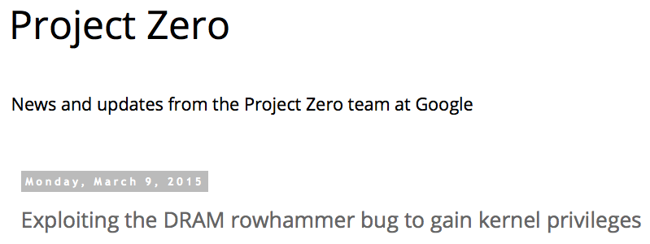
One Can Take Over an Otherwise-Secure System
Flipping Bits in Memory Without Accessing Them: An Experimental Study of DRAM Disturbance Errors (Kim et al., ISCA 2014)
Exploiting the DRAM rowhammer bug to gain kernel privileges (Seaborn, 2015)

Slide 48
RowHammer Security Attack Example
“Rowhammer” is a problem with some recent DRAM devices in which repeatedly accessing a row of memory can cause bit flips in adjacent rows (Kim et al., ISCA 2014).
  Flipping Bits in Memory Without Accessing Them: An Experimental Study of DRAM Disturbance Errors (Kim et al., ISCA 2014)
We tested a selection of laptops and found that a subset of them exhibited the problem.
We built two working privilege escalation exploits that use this effect.
  Exploiting the DRAM rowhammer bug to gain kernel privileges (Seaborn+, 2015)
One exploit uses rowhammer-induced bit flips to gain kernel privileges on x86-64 Linux when run as an unprivileged userland process.
When run on a machine vulnerable to the rowhammer problem, the process was able to induce bit flips in page table entries (PTEs).
It was able to use this to gain write access to its own page table, and hence gain read-write access to all of physical memory.
Exploiting the DRAM rowhammer bug to gain kernel privileges (Seaborn & Dullien, 2015)

Slide 49
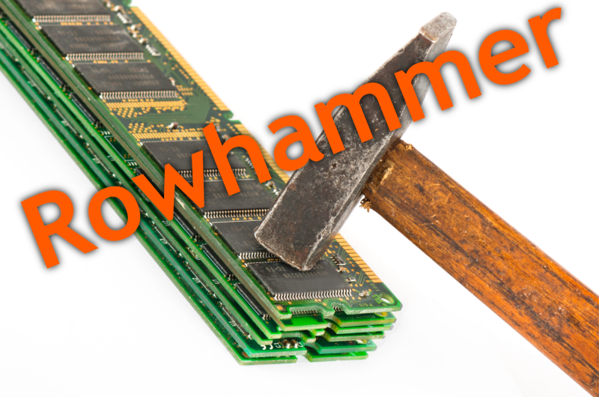
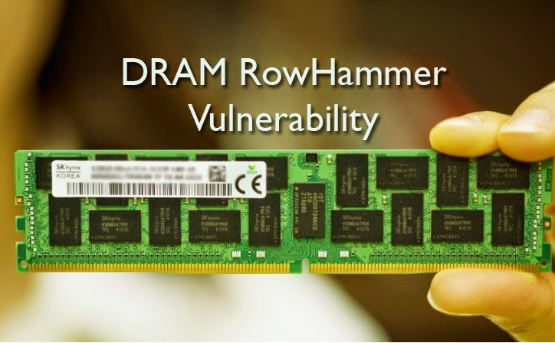
Security Implications
Notes:
Picture from the article:
http://thehackernews.com/2015/03/dram-rowhammer-vulnerability.html

Slide 50
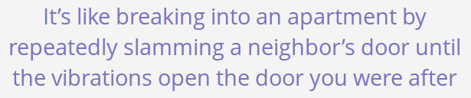
Security Implications
Notes:
Picture from the article:
http://thehackernews.com/2015/03/dram-rowhammer-vulnerability.html

Slide 51
Selected Readings on RowHammer (I)
Our first detailed study: Rowhammer analysis and solutions (June 2014)
  Yoongu Kim, Ross Daly, Jeremie Kim, Chris Fallin, Ji Hye Lee, Donghyuk Lee, Chris Wilkerson, Konrad Lai, and Onur Mutlu,
  "Flipping Bits in Memory Without Accessing Them: An Experimental Study of DRAM Disturbance Errors"
  Proceedings of the 41st International Symposium on Computer Architecture (ISCA), Minneapolis, MN, June 2014. [Slides (pptx) (pdf)] [Lightning Session Slides (pptx) (pdf)] [Source Code and Data]
Our Source Code to Induce Errors in Modern DRAM Chips (June 2014)
  https://github.com/CMU-SAFARI/rowhammer
Google Project Zero’s Attack to Take Over a System (March 2015)
  Exploiting the DRAM rowhammer bug to gain kernel privileges (Seaborn+, 2015)
  https://github.com/google/rowhammer-test
  Double-sided Rowhammer

Slide 52
Selected Readings on RowHammer (II)
Remote RowHammer Attacks via JavaScript (July 2015)
  http://arxiv.org/abs/1507.06955
  https://github.com/IAIK/rowhammerjs
  Gruss et al., DIMVA 2016.
  CLFLUSH-free Rowhammer
  “A fully automated attack that requires nothing but a website with JavaScript to trigger faults on remote hardware.”
  “We can gain unrestricted access to systems of website visitors.”
ANVIL: Software-Based Protection Against Next-Generation Rowhammer Attacks (March 2016)
  http://dl.acm.org/citation.cfm?doid=2872362.2872390
  Aweke et al., ASPLOS 2016
  CLFLUSH-free Rowhammer
  Software based monitoring for rowhammer detection

Slide 53
Selected Readings on RowHammer (III)
Dedup Est Machina: Memory Deduplication as an Advanced Exploitation Vector (May 2016)
  https://www.ieee-security.org/TC/SP2016/papers/0824a987.pdf
  Bosman et al., IEEE S&P 2016.
  Exploits Rowhammer and Memory Deduplication to overtake a browser
  “We report on the first reliable remote exploit for the Rowhammer vulnerability running entirely in Microsoft Edge.”
  “[an attacker] … can reliably “own” a system with all defenses up, even if the software is entirely free of bugs.”
CAn’t Touch This: Software-only Mitigation against Rowhammer Attacks targeting Kernel Memory (August 2017)
  https://www.usenix.org/system/files/conference/usenixsecurity17/sec17-brasser.pdf
  Brasser et al., USENIX Security 2017.
  Partitions physical memory into security domains, user vs. kernel; limits rowhammer-induced bit flips to the user domain.

Slide 54
Selected Readings on RowHammer (IV)
A New Approach for Rowhammer Attacks (May 2016)
  https://ieeexplore.ieee.org/document/7495576
  Qiao et al., HOST 2016
  CLFLUSH-free RowHammer
  “Libc functions memset and memcpy are found capable of rowhammer.”
  Triggers RowHammer with malicious inputs but benign code
One Bit Flips, One Cloud Flops: Cross-VM Row Hammer Attacks and Privilege Escalation (August 2016)
  https://www.usenix.org/system/files/conference/usenixsecurity16/sec16_paper_xiao.pdf
  Xiao et al., USENIX Security 2016.
  “Technique that allows a malicious guest VM to have read and write accesses to arbitrary physical pages on a shared machine.”
  Graph-based algorithm to reverse engineer mapping of physical addresses in DRAM

Slide 55
Selected Readings on RowHammer (V)
Curious Case of RowHammer: Flipping Secret Exponent Bits using Timing Analysis (August 2016)
  https://link.springer.com/content/pdf/10.1007%2F978-3-662-53140-2_29.pdf
  Bhattacharya et al., CHES 2016
  Combines timing analysis to perform rowhammer on cryptographic keys stored in memory
DRAMA: Exploiting DRAM Addressing for Cross-CPU Attacks (August 2016)
  https://www.usenix.org/system/files/conference/usenixsecurity16/sec16_paper_pessl.pdf
  Pessl et al., USENIX Security 2016
  Shows RowHammer failures on DDR4 devices despite TRR solution
  Reverse engineers address mapping functions to improve existing RowHammer attacks

Slide 56
Selected Readings on RowHammer (VI)
Flip Feng Shui: Hammering a Needle in the Software Stack (August 2016)
  https://www.usenix.org/system/files/conference/usenixsecurity16/sec16_paper_razavi.pdf
  Razavi et al., USENIX Security 2016.
  Combines memory deduplication and RowHammer
  “A malicious VM can gain unauthorized access to a co-hosted VM running OpenSSH.”
  Breaks OpenSSH public key authentication
Drammer: Deterministic Rowhammer Attacks on Mobile Platforms (October 2016)
  http://dl.acm.org/citation.cfm?id=2976749.2978406
  Van Der Veen et al., ACM CCS 2016
  Can take over an ARM-based Android system deterministically
  Exploits predictable physical memory allocator behavior
    Can deterministically place security-sensitive data (e.g., page table) in an attacker-chosen, vulnerable location in memory

Slide 57
Selected Readings on RowHammer (VII)
When Good Protections go Bad: Exploiting anti-DoS Measures to Accelerate Rowhammer Attacks (May 2017)
  https://web.eecs.umich.edu/~misiker/resources/HOST-2017-Misiker.pdf
  Aga et al., HOST 2017
  “A virtual-memory based cache-flush free attack that is sufficiently fast to rowhammer with double rate refresh.”
  Enabled by Cache Allocation Technology
SGX-Bomb: Locking Down the Processor via Rowhammer Attack (October 2017)
  https://dl.acm.org/citation.cfm?id=3152709
  Jang et al., SysTEX 2017
  “Launches the Rowhammer attack against enclave memory to trigger the processor lockdown.”
  Running unknown enclave programs on the cloud can shut down servers shared with other clients.

Slide 58
Selected Readings on RowHammer (VIII)
Another Flip in the Wall of Rowhammer Defenses (May 2018)
  https://arxiv.org/pdf/1710.00551.pdf
  Gruss et al., IEEE S&P 2018
  A new type of Rowhammer attack which only hammers one single address, which can be done without knowledge of physical addresses and DRAM mappings
  Defeats static analysis and performance counter analysis defenses by running inside an SGX enclave
GuardION: Practical Mitigation of DMA-Based Rowhammer Attacks on ARM (June 2018)
  https://link.springer.com/chapter/10.1007/978-3-319-93411-2_5
  Van Der Veen et al., DIMVA 2018
  Presents RAMPAGE, a DMA-based RowHammer attack against the latest Android OS

Slide 59
Selected Readings on RowHammer (IX)
Grand Pwning Unit: Accelerating Microarchitectural Attacks with the GPU (May 2018)
  https://www.vusec.net/wp-content/uploads/2018/05/glitch.pdf
  Frigo et al., IEEE S&P 2018.
  The first end-to-end remote Rowhammer exploit on mobile platforms that use our GPU-based primitives in orchestration to compromise browsers on mobile devices in under two minutes.
Throwhammer: Rowhammer Attacks over the Network and Defenses (July 2018)
  https://www.cs.vu.nl/~herbertb/download/papers/throwhammer_atc18.pdf
  Tatar et al., USENIX ATC 2018.
  “[We] show that an attacker can trigger and exploit Rowhammer bit flips directly from a remote machine by only sending network packets.”

Slide 60
Selected Readings on RowHammer (X)
Nethammer: Inducing Rowhammer Faults through Network Requests (July 2018)
  https://arxiv.org/pdf/1805.04956.pdf
  Lipp et al., arxiv.org 2018.
  “Nethammer is the first truly remote Rowhammer attack, without a single attacker-controlled line of code on the targeted system.”
ZebRAM: Comprehensive and Compatible Software Protection Against Rowhammer Attacks (October 2018)
  https://www.usenix.org/system/files/osdi18-konoth.pdf
  Konoth et al., OSDI 2018
  A new pure-software protection mechanism against RowHammer.

Slide 61
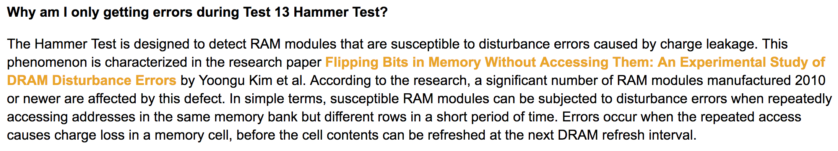
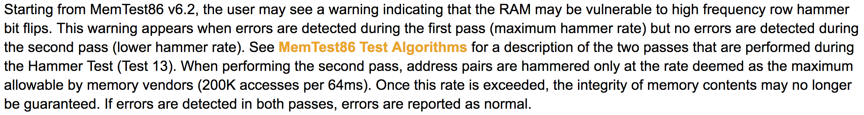
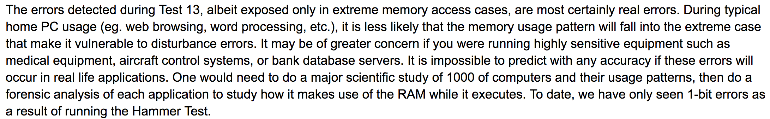
Selected Readings on RowHammer (XI.A)
PassMark Software, memtest86, since 2014
  https://www.memtest86.com/troubleshooting.htm#hammer

Slide 62
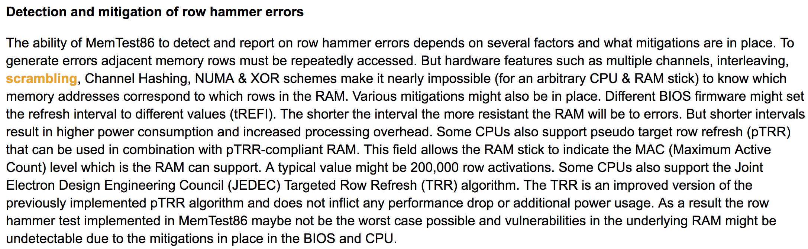

Selected Readings on RowHammer (XI.B)
PassMark Software, memtest86, since 2014
  https://www.memtest86.com/troubleshooting.htm#hammer

Slide 63
Security Implications (ISCA 2014)
Breach of memory protection
  OS page (4KB) fits inside DRAM row (8KB)
  Adjacent DRAM row → Different OS page
Vulnerability: disturbance attack
  By accessing its own page, a program could
  corrupt pages belonging to another program
We constructed a proof-of-concept
  Using only user-level instructions
Notes:
In addition, they have serious implications for security
When disturbance errors occur, they could breach memory protection. This is because an OS page fits inside a DRAM row. So an error in a different DRAM row means an error in a different OS page.
This opens up a vulnerability to disturbance attacks. Just by accessing its own page, a malicious program could corrupt pages belonging to another program.
And, as shown previously, we constructed a proof-of-concept using only user-level instructions.

Slide 64

More Security Implications (I)
“We can gain unrestricted access to systems of website visitors.”
Rowhammer.js: A Remote Software-Induced Fault Attack in JavaScript (DIMVA’16)
Source: https://lab.dsst.io/32c3-slides/7197.html

Slide 65

More Security Implications (II)
  “Can gain control of a smart phone deterministically”
Drammer: Deterministic Rowhammer Attacks on Mobile Platforms, CCS’16
Source: https://fossbytes.com/drammer-rowhammer-attack-android-root-devices/

Slide 66
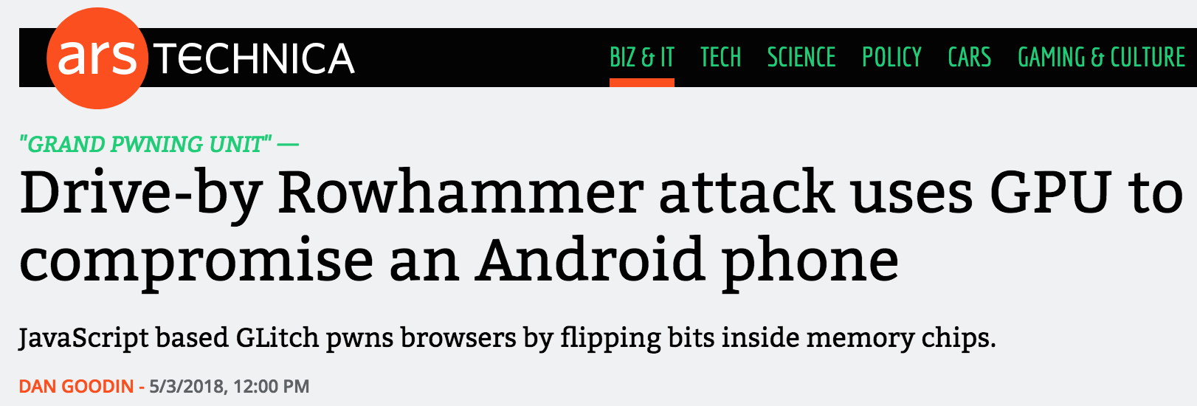

More Security Implications (III)
Using an integrated GPU in a mobile system to remotely escalate privilege via the WebGL interface

Slide 67
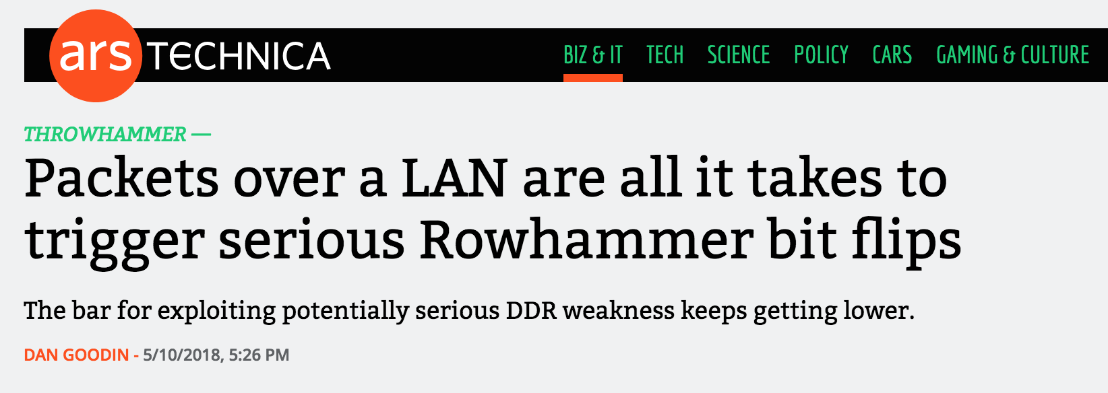
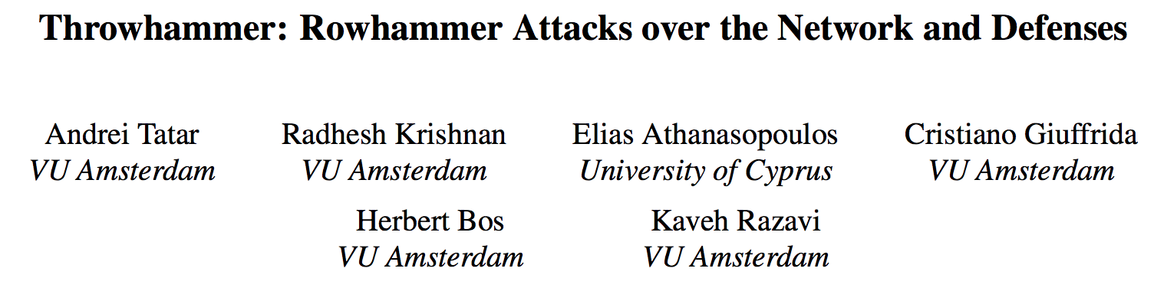
More Security Implications (IV)
Rowhammer over RDMA (I)

Slide 68


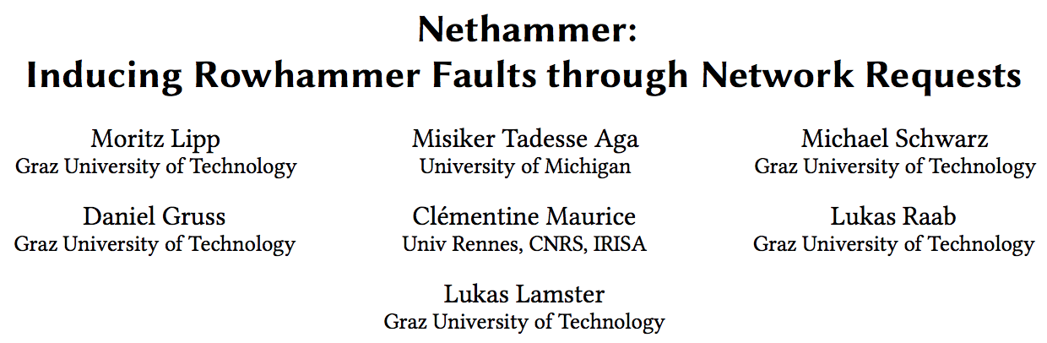
More Security Implications (V)
Rowhammer over RDMA (II)

Slide 69

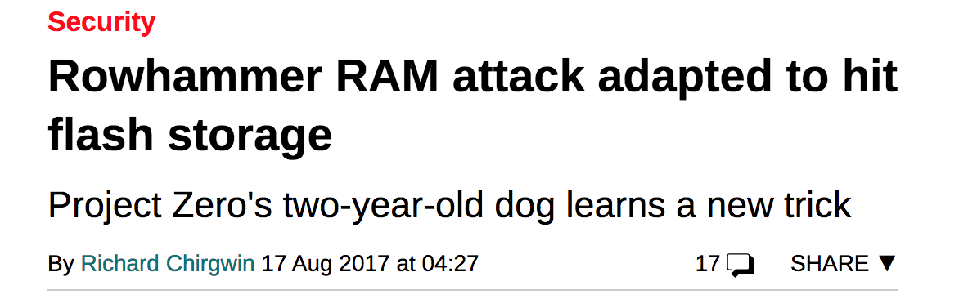
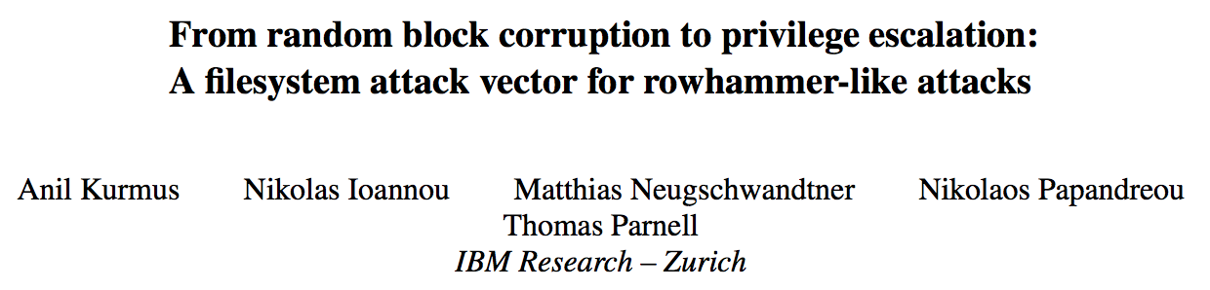
More Security Implications (VI)
Rowhammer on MLC NAND Flash (based on [Cai+, HPCA 2017])

Slide 70
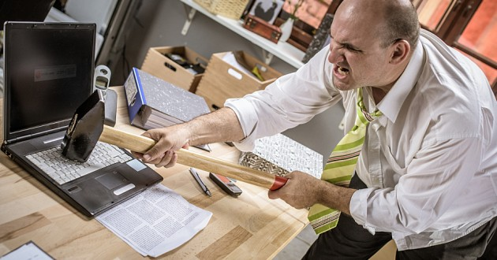
More Security Implications?

Slide 71
Understanding RowHammer

Slide 72
Root Causes of Disturbance Errors
Cause 1: Electromagnetic coupling
  Toggling the wordline voltage briefly increases the voltage of adjacent wordlines
  Slightly opens adjacent rows → Charge leakage
Cause 2: Conductive bridges
Cause 3: Hot-carrier injection
Confirmed by at least one manufacturer
Notes:
Why do the errors occur? We see three possible causes.
First, there could electromagnetic coupling between adjacent wordlines. When the voltage of one is toggled, it could briefly increase the voltage of the other and facilitate the leakage of charge.
Two other possibilities are conductive bridges and hot-carrier injection.
At least one manufacturer confirmed that these three could play a role in the disturbance errors we see them today.

Slide 73
Experimental DRAM Testing Infrastructure
  An Experimental Study of Data Retention Behavior in Modern DRAM Devices: Implications for Retention Time Profiling Mechanisms (Liu et al., ISCA 2013)
  The Efficacy of Error Mitigation Techniques for DRAM Retention Failures: A Comparative Experimental Study
  (Khan et al., SIGMETRICS 2014)
  Flipping Bits in Memory Without Accessing Them: An Experimental Study of DRAM Disturbance Errors (Kim et al., ISCA 2014)
  Adaptive-Latency DRAM: Optimizing DRAM Timing for the Common-Case (Lee et al., HPCA 2015)
  AVATAR: A Variable-Retention-Time (VRT) Aware Refresh for DRAM Systems (Qureshi et al., DSN 2015)

Slide 74
Where RowHammer Was Discovered
Temperature
Controller
FPGAs
Heater
FPGAs
PC
  Kim+, “Flipping Bits in Memory Without Accessing Them: An Experimental Study of DRAM Disturbance Errors,” ISCA 2014.

Slide 75
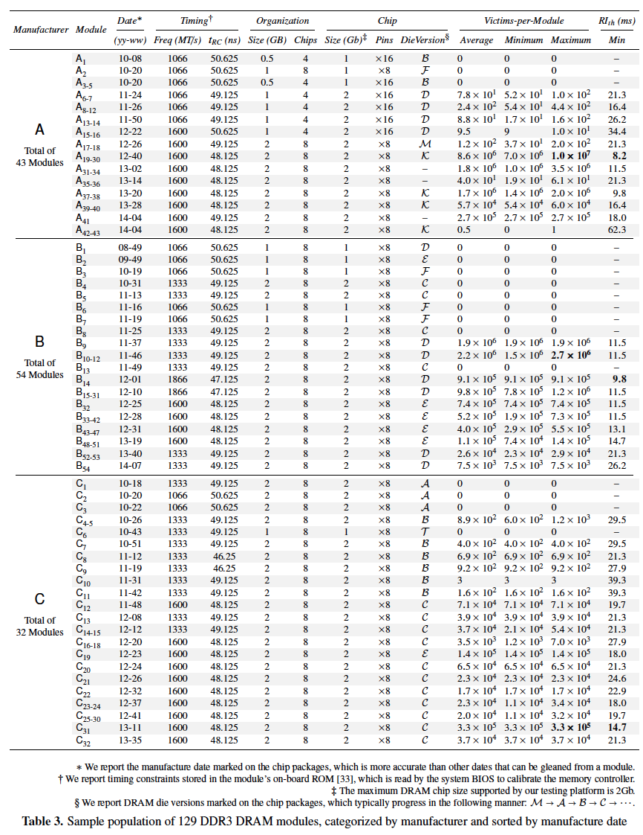
Tested
DRAM
Modules
(129 total)

Slide 76
RowHammer Characterization Results
Most Modules Are at Risk
Errors vs. Vintage
Error = Charge Loss
Adjacency: Aggressor & Victim
Sensitivity Studies
Other Results in Paper
Solution Space
Flipping Bits in Memory Without Accessing Them: An Experimental Study of DRAM Disturbance Errors, (Kim et al., ISCA 2014)
Notes:
Now I will present the characterization results, one-by-one.
First, I show that most modules are at risk. Second, I show the number of errors in a module as a function of the manufacture date. Third, I show that the errors are symptomatic of charge loss. Fourth, I show that an aggressor induces errors in adjacent rows. Fifth, I show several sensitivity studies. And, finally, I briefly describe other results in the paper.

Slide 77
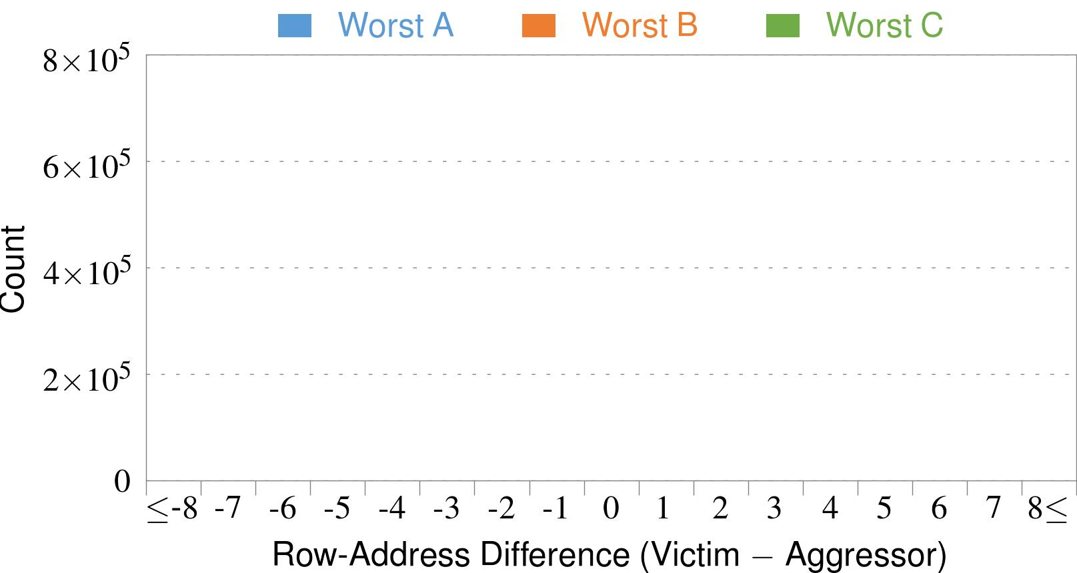
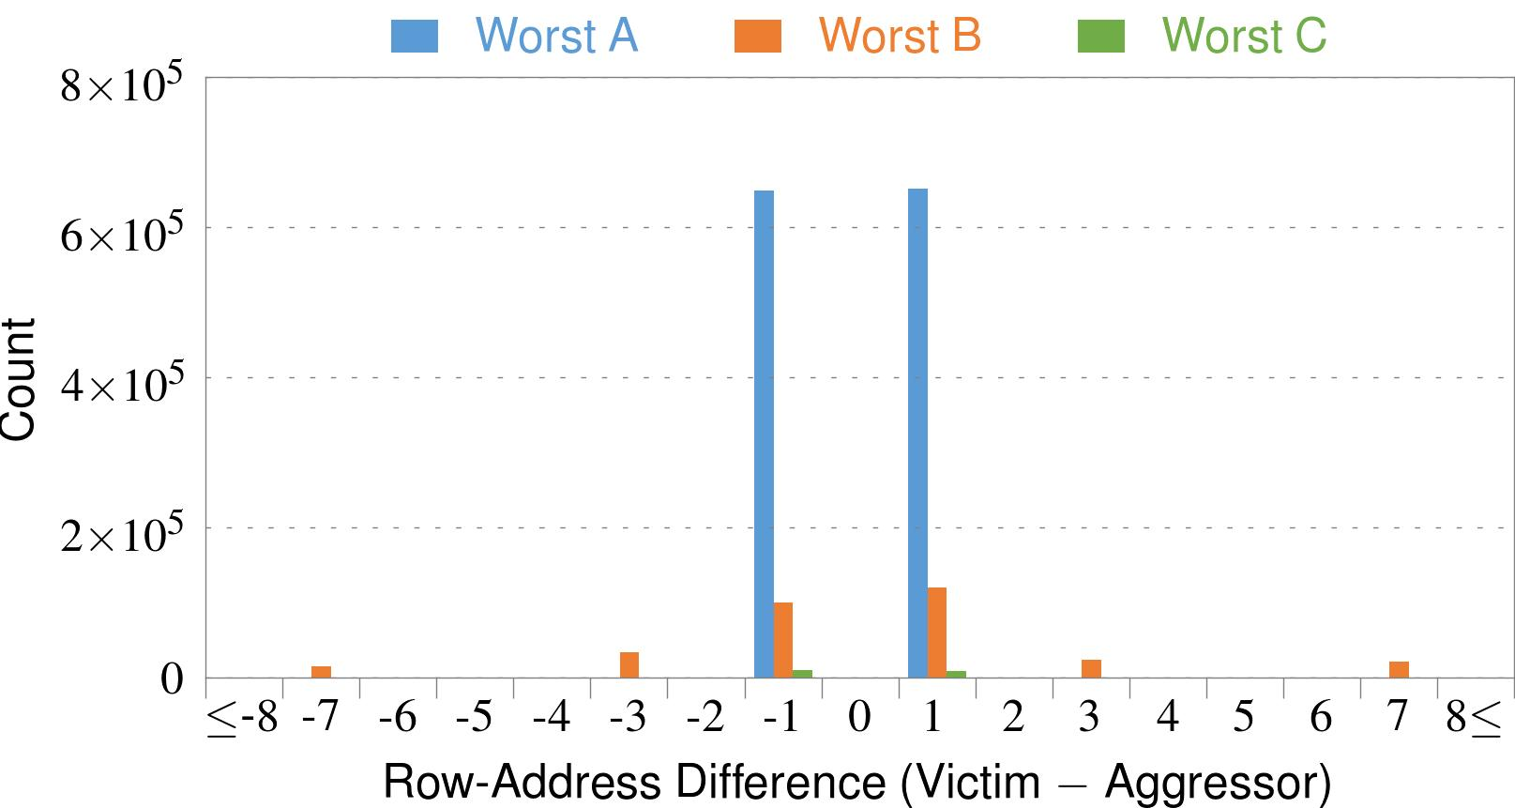
4. Adjacency: Aggressor & Victim
Adjacent
Adjacent
Adjacent
Non-Adjacent
Non-Adjacent
Note: For three modules with the most errors (only first bank)
Most aggressors & victims are adjacent
Notes:
In this figure, the x-axis is the row-address difference between an aggressor and its victims. And the y-axis is the number of victim-aggressor pairs that correspond to the row-address difference. For all three modules, we see strong peaks at plus/minus 1. This implies that aggressors and victims have consecutive row-addresses, in other words, they are adjacent.
However, the figure also shows some victims that are not adjacent to the aggressor. We believe this could be caused by two reasons. First, depending on the mapping, two rows that are physically adjacent within the DRAM chip may not have consecutive row-addresses. Second, fault rows are often re-mapped to spare rows that may reside on a different portion of the DRAM chip.
Nevertheless, we conclude that the vast majority of aggressors & victims are adjacent.

Slide 78
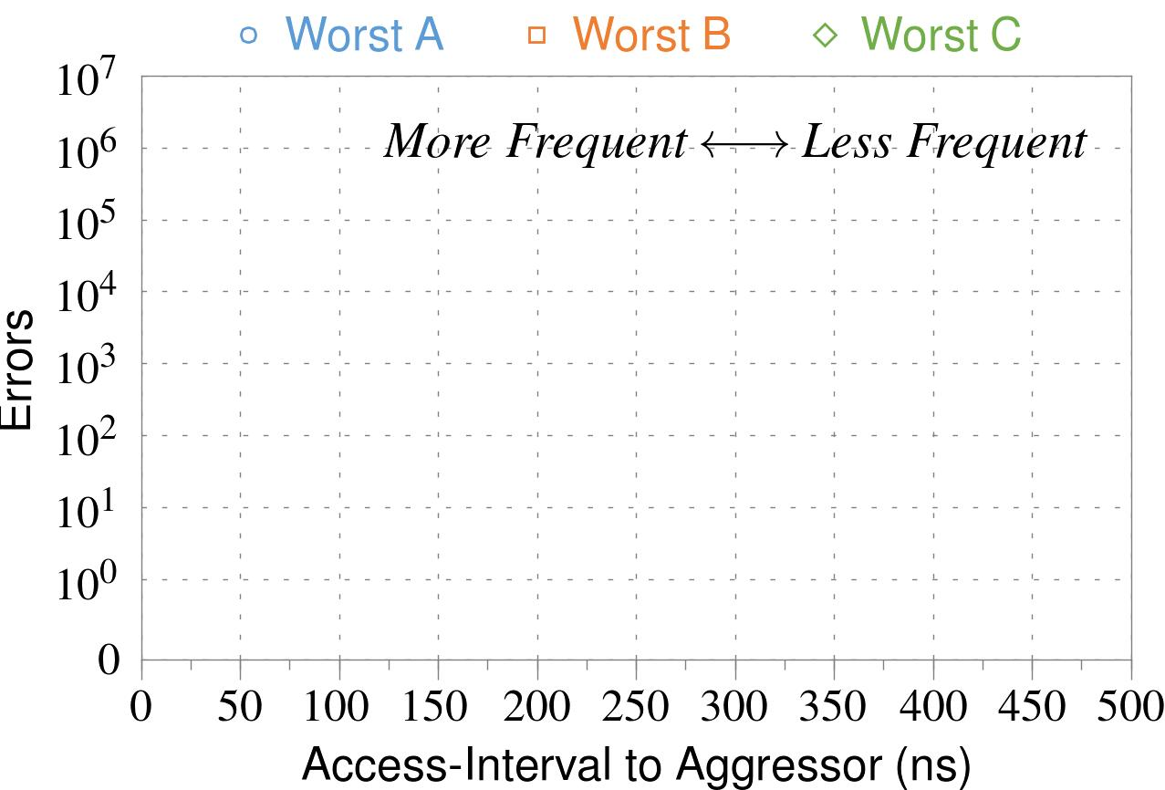
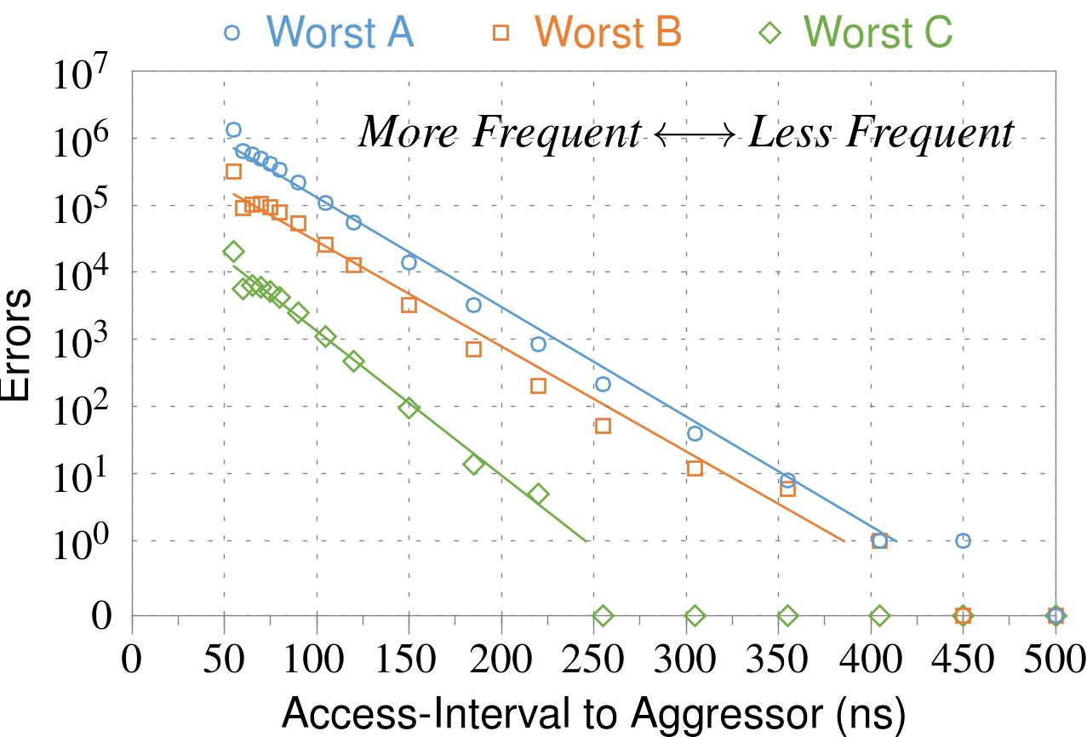
❶ Access Interval (Aggressor)
Not Allowed
500ns
55ns
Note: For three modules with the most errors (only first bank)
Less frequent accesses → Fewer errors
Notes:
In this figure, the x-axis is the interval at which we access the aggressor. And the y-axis is the number of errors. To comply with the DRAM standard, we employ a default value of 55ns in our experiments. However, as we increase the access-interval, we see that the number of errors decreases. In particular, at 500ns, there are no errors for all three modules.
From this, we conclude that less frequent accesses induce fewer errors.

Slide 79


❷ Refresh Interval
~7x frequent
64ms
Note: Using three modules with the most errors (only first bank)
More frequent refreshes → Fewer errors
Notes:
In this figure, the x-axis is the refresh-interval. And the y-axis is the number of errors. To comply with the DRAM standard, we employ a default value of 64ms in our experiments. However, as we decrease the refresh-interval, we see that the number of errors decreases. In particular, when the refresh is shortened by 7x, there are no errors for all three modules.
From this, we conclude that more frequent accesses induce fewer errors.

Slide 80
❸ Data Pattern
Solid
RowStripe
111111
111111
111111
000000
111111
111111
10x Errors
111111
000000
~Solid
~RowStripe
000000
000000
000000
111111
000000
000000
000000
111111
Errors affected by data stored in other cells
Notes:
We tested the modules with four different data-patterns: Solid, inverse Solid, RowStripe, and inverse RowStripe. Solid and inverse Solid give us full coverage since each cell is tested with both 1s and 0s. And the same applies to RowStripe and its inverse.
However, we found that the rowstripe pattern had 10 times as more errors than the solid pattern. We also tested many other data-patterns, including random, but found RowStripe to induce the most errors.
Therefore, we conclude that errors are affected by data stored in other cells due to differences in coupling effects between the cells.

Slide 81
6. Other Results (in Paper)
Victim Cells ≠ Weak Cells (i.e., leaky cells)
  Almost no overlap between them
Errors not strongly affected by temperature
  Default temperature: 50°C
  At 30°C and 70°C, number of errors changes <15%
Errors are repeatable
  Across ten iterations of testing, >70% of victim cells had errors in every iteration
Notes:
First, we show that victim cells are not weak cells, which are cells that are inherently leaky. According to our experiments, we saw almost no overlap between them.
Second, we show that errors are not strongly affected by temperature. In all of the tests so far, we set the temperature to 50 degrees Celsius. But even when we changed the temperature by 20 degrees, the number of errors changed by less than 15 percent.
Third, we show that errors are repeatable. Across ten iterations of testing, more than 70% of victim cells had errors in every iteration.

Slide 82
6. Other Results (in Paper) cont’d
As many as 4 errors per cache-line
  Simple ECC (e.g., SECDED) cannot prevent all errors
Number of cells & rows affected by aggressor
  Victims cells per aggressor: ≤110
  Victims rows per aggressor: ≤9
Cells affected by two aggressors on either side
  Very small fraction of victim cells (<100) have an error when either one of the aggressors is toggled
Notes:
Fourth, we show that there are as many as four errors per cacheline. From this, we conclude that simple ECC schemes (for example, SECDED) cannot prevent all errors.
Fifth, we show that the number of cells & rows affected by an aggressor can be as high as 110 or 9, respectively.
Lastly, we show that a very small fraction of victim cells experience an error when either one of the aggressors is toggled.

Slide 83

First RowHammer Analysis
Yoongu Kim, Ross Daly, Jeremie Kim, Chris Fallin, Ji Hye Lee, Donghyuk Lee, Chris Wilkerson, Konrad Lai, and Onur Mutlu,
"Flipping Bits in Memory Without Accessing Them: An Experimental Study of DRAM Disturbance Errors"
Proceedings of the 41st International Symposium on Computer Architecture (ISCA), Minneapolis, MN, June 2014.
[Slides (pptx) (pdf)] [Lightning Session Slides (pptx) (pdf)] [Source Code and Data]

Slide 84

Retrospective on RowHammer & Future
Onur Mutlu,
"The RowHammer Problem and Other Issues We May Face as Memory Becomes Denser"
Invited Paper in Proceedings of the Design, Automation, and Test in Europe Conference (DATE), Lausanne, Switzerland, March 2017.
[Slides (pptx) (pdf)]
https://people.inf.ethz.ch/omutlu/pub/rowhammer-and-other-memory-issues_date17.pdf

Slide 85
RowHammer Solutions

Slide 86
Two Types of RowHammer Solutions
Immediate
  To protect the vulnerable DRAM chips in the field
  Limited possibilities
Longer-term
  To protect future DRAM chips
  Wider range of protection mechanisms
Our ISCA 2014 paper proposes both types of solutions
  Seven solutions in total
  PARA proposed as best solution → already employed in the field

Slide 87
Some Potential Solutions (ISCA 2014)
Cost
Make better DRAM chips
Power, Performance
Refresh frequently
Cost, Power
Sophisticated ECC
Cost, Power, Complexity
Access counters
Notes:
Here is a list of four potential solutions to disturbance errors: making better DRAM chips, refreshing more frequently, employing sophisticated ECC schemes, and using hardware counters to track the number of accesses to different rows.
However, all of these solutions incur a large overhead in terms cost, power, performance, and/or complexity.

Slide 88
Naive Solutions
❶ Throttle accesses to same row
  Limit access-interval: ≥500ns
  Limit number of accesses: ≤128K (=64ms/500ns)
❷ Refresh more frequently
  Shorten refresh-interval by ~7x
Both naive solutions introduce significant overhead in performance and power
Notes:
Based on what we learned from the sensitivity studies, there are two naive solutions that immediately present themselves.
First, we can throttle accesses to the same row. If the access-interval is greater than 500ns, I showed how errors are not induced. We can achieve the same effect by limiting the maximum number of accesses to the same row to be less than 128K, within a refresh interval.
Second, we can refresh the module more frequently. If the refresh-interval is shortened by 7x, I showed how errors can be prevented.
However, both naive solutions introduce significant overhead in both performance and power. Later on, I will propose a much more efficient solution.

Slide 89

Apple’s Patch for RowHammer
https://support.apple.com/en-gb/HT204934
HP, Lenovo, and other vendors released similar patches

Slide 90
Our Best Solution to RowHammer
PARA: Probabilistic Adjacent Row Activation
Key Idea
  After closing a row, we activate (i.e., refresh) one of its neighbors with a low probability: p = 0.005
Reliability Guarantee
  When p=0.005, errors in one year: 9.4×10⁻¹⁴
  By adjusting the value of p, we can vary the strength of protection against errors
Notes:
We provide a more efficient solution, called PARA, which stands for probabilistic adjacent row activation.
The key idea is thus: after closing a row, we activate (i.e., refresh) one of its neighbors with a low probability, for example, p equal to 0.005.
PARA provides a strong reliability guarantee even under the worst-case access patterns to DRAM. When we set p to 0.005, the expected number of errors in one year is 9.4 times 10 to the negative 14. This probability is much lower the failure rate of other hardware components, for example, the hard-disk drive.
And by adjusting the value of p, PARA can provide an arbitrarily strong-degree of protection against errors.

Slide 91
Advantages of PARA
PARA refreshes rows infrequently
  Low power
  Low performance-overhead
    Average slowdown: 0.20% (for 29 benchmarks)
    Maximum slowdown: 0.75%
PARA is stateless
  Low cost
  Low complexity
PARA is an effective and low-overhead solution to prevent disturbance errors
Notes:
PARA has many advantages. Since it refreshes row infrequently, it has low power and low performance-overhead. Simulated across 29 benchmarks, we saw an average of only 0.2% slowdown and a maximum of only 0.75% slowdown.
In addition, due to its stateless nature, PARA has low cost and complexity.
Therefore, PARA is an effective and low-overhead solution to prevent disturbance errors.

Slide 92
Requirements for PARA
If implemented in DRAM chip (done today)
  Enough slack in timing and refresh parameters
  Plenty of slack today:
    Lee et al., “Adaptive-Latency DRAM: Optimizing DRAM Timing for the Common Case,” HPCA 2015.
    Chang et al., “Understanding Latency Variation in Modern DRAM Chips,” SIGMETRICS 2016.
    Lee et al., “Design-Induced Latency Variation in Modern DRAM Chips,” SIGMETRICS 2017.
    Chang et al., “Understanding Reduced-Voltage Operation in Modern DRAM Devices,” SIGMETRICS 2017.
    Ghose et al., “What Your DRAM Power Models Are Not Telling You: Lessons from a Detailed Experimental Study,” SIGMETRICS 2018.
If implemented in memory controller
  Better coordination between memory controller and DRAM
  Memory controller should know which rows are physically adjacent

Slide 93

Probabilistic Activation in Real Life (I)
https://twitter.com/isislovecruft/status/1021939922754723841

Slide 94

Probabilistic Activation in Real Life (II)
https://twitter.com/isislovecruft/status/1021939922754723841

Slide 95
Seven RowHammer Solutions Proposed
Yoongu Kim, Ross Daly, Jeremie Kim, Chris Fallin, Ji Hye Lee, Donghyuk Lee, Chris Wilkerson, Konrad Lai, and Onur Mutlu,
"Flipping Bits in Memory Without Accessing Them: An Experimental Study of DRAM Disturbance Errors"
Proceedings of the 41st International Symposium on Computer Architecture (ISCA), Minneapolis, MN, June 2014.
[Slides (pptx) (pdf)] [Lightning Session Slides (pptx) (pdf)] [Source Code and Data]

Slide 96
A Takeaway
Main Memory Needs
Intelligent Controllers
for Security

Slide 97

Aside: Intelligent Controller for NAND Flash
USB Daughter Board
USB Jack
HAPS-52 Mother Board
Virtex-II Pro
(USB controller)
1x-nm
NAND Flash
Virtex-V FPGA
(NAND Controller)
[DATE 2012, ICCD 2012, DATE 2013, ITJ 2013, ICCD 2013, SIGMETRICS 2014, HPCA 2015, DSN 2015, MSST 2015, JSAC 2016, HPCA 2017, DFRWS 2017,
PIEEE 2017, HPCA 2018, SIGMETRICS 2018]
NAND Daughter Board
Cai+, “Error Characterization, Mitigation, and Recovery in Flash Memory Based Solid State Drives,” Proc. IEEE 2017.

Slide 98
Future Memory Reliability/Security Challenges

Slide 99
Future of RowHammer & Memory Reliability
Onur Mutlu,
"The RowHammer Problem and Other Issues We May Face as Memory Becomes Denser"
Invited Paper in Proceedings of the Design, Automation, and Test in Europe Conference (DATE), Lausanne, Switzerland, March 2017.
[Slides (pptx) (pdf)]
https://people.inf.ethz.ch/omutlu/pub/rowhammer-and-other-memory-issues_date17.pdf

Slide 100
Future of Main Memory
DRAM is becoming less reliable → more vulnerable

Slide 101
Large-Scale Failure Analysis of DRAM Chips
Analysis and modeling of memory errors found in all of Facebook’s server fleet
Justin Meza, Qiang Wu, Sanjeev Kumar, and Onur Mutlu,
"Revisiting Memory Errors in Large-Scale Production Data Centers: Analysis and Modeling of New Trends from the Field"
Proceedings of the 45th Annual IEEE/IFIP International Conference on Dependable Systems and Networks (DSN), Rio de Janeiro, Brazil, June 2015.
[Slides (pptx) (pdf)] [DRAM Error Model]

Slide 102
DRAM Reliability Reducing
Intuition:
quadratic
increase in
capacity
Meza+, “Revisiting Memory Errors in Large-Scale Production Data Centers,” DSN’15.

Slide 103
Future of Main Memory Security
DRAM is becoming less reliable → more vulnerable
Due to difficulties in DRAM scaling, other problems may also appear (or they may be going unnoticed)
Some errors may already be slipping into the field
  Read disturb errors (Rowhammer)
  Retention errors
  Read errors, write errors
  …
These errors can also pose security vulnerabilities

Slide 104
Data Retention Errors

Slide 105
DRAM Data Retention Time Failures
Determining the data retention time of a cell/row is getting more difficult
Retention failures may already be slipping into the field

Slide 106
Analysis of Data Retention Failures [ISCA’13]
Jamie Liu, Ben Jaiyen, Yoongu Kim, Chris Wilkerson, and Onur Mutlu,
"An Experimental Study of Data Retention Behavior in Modern DRAM Devices: Implications for Retention Time Profiling Mechanisms"
Proceedings of the 40th International Symposium on Computer Architecture (ISCA), Tel-Aviv, Israel, June 2013. Slides (ppt) Slides (pdf)

Slide 107
Two Challenges to Retention Time Profiling
Data Pattern Dependence (DPD) of retention time
Variable Retention Time (VRT) phenomenon

Slide 108

Two Challenges to Retention Time Profiling
Challenge 1: Data Pattern Dependence (DPD)
  Retention time of a DRAM cell depends on its value and the values of cells nearby it
  When a row is activated, all bitlines are perturbed simultaneously

Slide 109
Data Pattern Dependence
Electrical noise on the bitline affects reliable sensing of a DRAM cell
The magnitude of this noise is affected by values of nearby cells via
  Bitline-bitline coupling → electrical coupling between adjacent bitlines
  Bitline-wordline coupling → electrical coupling between each bitline and the activated wordline
Notes:
If a cell has lost enough charge, this noise can be large enough to cause a failure on a read
(normally, there is enough noise margin to tolerate the coupling noise)

Slide 110
Data Pattern Dependence
Electrical noise on the bitline affects reliable sensing of a DRAM cell
The magnitude of this noise is affected by values of nearby cells via
  Bitline-bitline coupling → electrical coupling between adjacent bitlines
  Bitline-wordline coupling → electrical coupling between each bitline and the activated wordline
Retention time of a cell depends on data patterns stored in nearby cells
→ need to find the worst data pattern to find worst-case retention time
→ this pattern is location dependent
Notes:
If a cell has lost enough charge, this noise can be large enough to cause a failure on a read
(normally, there is enough noise margin to tolerate the coupling noise)

Slide 111
Two Challenges to Retention Time Profiling
Challenge 2: Variable Retention Time (VRT)
  Retention time of a DRAM cell changes randomly over time
    a cell alternates between multiple retention time states
  Leakage current of a cell changes sporadically due to a charge trap in the gate oxide of the DRAM cell access transistor
  When the trap becomes occupied, charge leaks more readily from the transistor’s drain, leading to a short retention time
    Called Trap-Assisted Gate-Induced Drain Leakage
  This process appears to be a random process [Kim+ IEEE TED’11]
  Worst-case retention time depends on a random process
    → need to find the worst case despite this

Slide 112
An Example VRT Cell
A cell from E 2Gb chip family

Slide 113
Variable Retention Time
Many failing cells jump from
very high retention time to very low
Most failing cells
exhibit VRT
Min ret time = Max ret time
Expected if no VRT
A 2Gb chip family

Slide 114
Industry Is Writing Papers About It, Too

Slide 115
Industry Is Writing Papers About It, Too

Slide 116
Mitigation of Retention Issues [SIGMETRICS’14]
Samira Khan, Donghyuk Lee, Yoongu Kim, Alaa Alameldeen, Chris Wilkerson, and Onur Mutlu,
"The Efficacy of Error Mitigation Techniques for DRAM Retention Failures: A Comparative Experimental Study"
Proceedings of the ACM International Conference on Measurement and Modeling of Computer Systems (SIGMETRICS), Austin, TX, June 2014. [Slides (pptx) (pdf)] [Poster (pptx) (pdf)] [Full data sets]

Slide 117
Towards an Online Profiling System
Key Observations:
Testing alone cannot detect all possible failures
Combination of ECC and other mitigation techniques is much more effective
  But degrades performance
Testing can help to reduce the ECC strength
  Even when starting with a higher strength ECC
Khan+, “The Efficacy of Error Mitigation Techniques for DRAM Retention Failures: A Comparative Experimental Study,” SIGMETRICS 2014.
Notes:
Our high-level design for online profiling system is based to thee key observations:

Slide 118


Towards an Online Profiling System
Initially Protect DRAM
with Strong ECC
Periodically Test
Parts of DRAM
1
2
Test
ECC
Test
Test
Mitigate errors and
reduce ECC
3
Run tests periodically after a short interval
at smaller regions of memory
Notes:
Based on these observations, we propose that in an online profiling system,

Slide 119

Handling Variable Retention Time [DSN’15]
Moinuddin Qureshi, Dae Hyun Kim, Samira Khan, Prashant Nair, and Onur Mutlu,
"AVATAR: A Variable-Retention-Time (VRT) Aware Refresh for DRAM Systems"
Proceedings of the 45th Annual IEEE/IFIP International Conference on Dependable Systems and Networks (DSN), Rio de Janeiro, Brazil, June 2015.
[Slides (pptx) (pdf)]

Slide 120

Handling Data-Dependent Failures [DSN’16]
Samira Khan, Donghyuk Lee, and Onur Mutlu,
"PARBOR: An Efficient System-Level Technique to Detect Data-Dependent Failures in DRAM"
Proceedings of the 45th Annual IEEE/IFIP International Conference on Dependable Systems and Networks (DSN), Toulouse, France, June 2016.
[Slides (pptx) (pdf)]

Slide 121
Handling Data-Dependent Failures [MICRO’17]
Samira Khan, Chris Wilkerson, Zhe Wang, Alaa R. Alameldeen, Donghyuk Lee, and Onur Mutlu,
"Detecting and Mitigating Data-Dependent DRAM Failures by Exploiting Current Memory Content"
Proceedings of the 50th International Symposium on Microarchitecture (MICRO), Boston, MA, USA, October 2017.
[Slides (pptx) (pdf)] [Lightning Session Slides (pptx) (pdf)] [Poster (pptx) (pdf)]

Slide 122

Handling Both DPD and VRT [ISCA’17]
Minesh Patel, Jeremie S. Kim, and Onur Mutlu,
"The Reach Profiler (REAPER): Enabling the Mitigation of DRAM Retention Failures via Profiling at Aggressive Conditions"
Proceedings of the 44th International Symposium on Computer Architecture (ISCA), Toronto, Canada, June 2017.
[Slides (pptx) (pdf)]
[Lightning Session Slides (pptx) (pdf)]
First experimental analysis of (mobile) LPDDR4 chips
Analyzes the complex tradeoff space of retention time profiling
Idea: enable fast and robust profiling at higher refresh intervals & temperatures

Slide 123
The Takeaway, Reinforced
Main Memory Needs
Intelligent Controllers
for Security

Slide 124
Keeping Future Memory Secure

Slide 125

NAND Flash Memory Vulnerabilities
Proceedings of the IEEE, Sept. 2017
https://arxiv.org/pdf/1706.08642

Slide 126
NAND Flash Vulnerabilities [HPCA’17]
HPCA, Feb. 2017
https://people.inf.ethz.ch/omutlu/pub/flash-memory-programming-vulnerabilities_hpca17.pdf

Slide 127
How Do We Keep Memory Secure?
DRAM
Flash memory
Emerging Technologies
  Phase Change Memory
  STT-MRAM
  RRAM, memristors
  …

Slide 128
Solution Direction: Principled Designs
Design fundamentally secure
computing architectures
Predict and prevent
such safety issues

Slide 129
Architecting Future Memory for Security
Understand: Methods for vulnerability modeling & discovery
  Modeling and prediction based on real (device) data and analysis
  Understanding vulnerabilities
  Developing reliable metrics
Architect: Principled architectures with security as key concern
  Good partitioning of duties across the stack
  Cannot give up performance and efficiency
  Patch-ability in the field
Design & Test: Principled design, automation, (online) testing
  Design for security
  High coverage and good interaction with system reliability methods

Slide 130
Understand and Model with Experiments (DRAM)
Temperature
Controller
FPGAs
Heater
FPGAs
PC
  Kim+, “Flipping Bits in Memory Without Accessing Them: An Experimental Study of DRAM Disturbance Errors,” ISCA 2014.

Slide 131
Understand and Model with Experiments (Flash)
USB Daughter Board
USB Jack
HAPS-52 Mother Board
Virtex-II Pro
(USB controller)
1x-nm
NAND Flash
Virtex-V FPGA
(NAND Controller)
[DATE 2012, ICCD 2012, DATE 2013, ITJ 2013, ICCD 2013, SIGMETRICS 2014, HPCA 2015, DSN 2015, MSST 2015, JSAC 2016, HPCA 2017, DFRWS 2017,
PIEEE 2017, HPCA 2018, SIGMETRICS 2018]
NAND Daughter Board
Cai+, “Error Characterization, Mitigation, and Recovery in Flash Memory Based Solid State Drives,” Proc. IEEE 2017.

Slide 132
Recall: Collapse of the “Galloping Gertie”
Source: AP
http://www.wsdot.wa.gov/tnbhistory/connections/connections3.htm

Slide 133

Another Example (1994)
Source: By 최광모 - Own work, CC BY-SA 4.0, https://commons.wikimedia.org/w/index.php?curid=35197984

Slide 134

Yet Another Example (2007)
Source: Morry Gash/AP,
https://www.npr.org/2017/08/01/540669701/10-years-after-bridge-collapse-america-is-still-crumbling?t=1535427165809

Slide 135

A More Recent Example (2018)
Source: AFP / Valery HACHE, https://www.capitalfm.co.ke/news/2018/08/genoa-bridge-collapse-what-we-know/

Slide 136
The Takeaway, Again
In-Field Patch-ability
(Intelligent Memory)
Can Avoid Such Failures

Slide 137
Memory Is Not Only Bad

Slide 138



D-RaNGe: Using Commodity DRAM Devices to Generate True Random Numbers with Low Latency and High Throughput
Jeremie S. Kim Minesh Patel
Hasan Hassan Lois Orosa Onur Mutlu
HPCA 2019

Slide 139
DRAM Latency Characterization of 282 LPDDR4 DRAM Devices
Latency failures come from accessing DRAM with reduced timing parameters.
Key Observations:
  A cell’s latency failure probability is determined by random process variation
  Some cells fail randomly
Notes:
In this work, we show results from a detailed experimental characterization of 282 state-of-the-art LPDDR4 DRAM devices. [CLICK] We characterize DRAM latency by observing the effects of accessing DRAM with DRAM timing parameters reduced below manufacturer-recommended values.
[CLICK] We make two key observations. [CLICK] first, a cell’s probability to fail, when accessed with reduced timing parameters, is directly correlated with random variations that arise from process manufacturing. [CLICK] secondly, We note that some cells fail randomly when accessed with a reduced tRCD.

Slide 140
D-RaNGe Key Idea
Low % chance to fail with reduced t_{RCD}
High % chance to fail with reduced t_{RCD}
Row Decoder
SA
SA
SA
SA
SA
SA
SA
Fails randomly
with reduced t_{RCD}
Notes:
Here is a cartoon showing the manufacturing variation across a region of DRAM. When accessed with a reduced timing parameter, [CLICK] some cells have a high percentage chance of failing, while others [CLICK] have a low percentage chance of failing. [CLICK} Some cells fail randomly when accessed with a reduced tRCD.

Slide 141
D-RaNGe Key Idea
Low % chance to fail with reduced t_{RCD}
High % chance to fail with reduced t_{RCD}
We refer to cells that fail randomly
when accessed with a reduced t_{RCD}
as RNG cells
Row Decoder
SA
SA
SA
SA
SA
SA
SA
Fails randomly
with reduced t_{RCD}
Notes:
We refer to cells that fail randomly when accessed with a reduced tRCD as RNG cells

Slide 142
Our D-RaNGe Evaluation
We generate random values by repeatedly accessing RNG cells and aggregating the data read
The random data satisfies the NIST statistical test suite for randomness
The D-RaNGE generates random numbers
  Throughput: 717.4 Mb/s
  Latency: 64 bits in <1us
  Power: 4.4 nJ/bit

Slide 143
D-RaNGe: Using Commodity DRAM Devices to Generate True Random Numbers with Low Latency and High Throughput
Jeremie S. Kim Minesh Patel
Hasan Hassan Lois Orosa Onur Mutlu
HPCA 2019

Slide 144

DRAM Latency True Random Number Generator
Jeremie S. Kim, Minesh Patel, Hasan Hassan, Lois Orosa, and Onur Mutlu,
"D-RaNGe: Using Commodity DRAM Devices to Generate True Random Numbers with Low Latency and High Throughput"
Proceedings of the 25th International Symposium on High-Performance Computer Architecture (HPCA), Washington, DC, USA, February 2019.

Slide 145

DRAM Latency PUFs
Jeremie S. Kim, Minesh Patel, Hasan Hassan, and Onur Mutlu,
"The DRAM Latency PUF: Quickly Evaluating Physical Unclonable Functions by Exploiting the Latency-Reliability Tradeoff in Modern DRAM Devices"
Proceedings of the 24th International Symposium on High-Performance Computer Architecture (HPCA), Vienna, Austria, February 2018.
[Lightning Talk Video]
[Slides (pptx) (pdf)] [Lightning Session Slides (pptx) (pdf)]

Slide 146

Quickly Destroying In-Memory Data
Dataplant: In-DRAM Security Mechanisms for Low-Cost Devices
  https://arxiv.org/pdf/1902.07344.pdf

Slide 147

For Some Other Time …

Slide 148
Conclusion

Slide 149
RowHammer, Revisited
One can predictably induce bit flips in commodity DRAM chips
  >80% of the tested DRAM chips are vulnerable
First example of how a simple hardware failure mechanism can create a widespread system security vulnerability

Slide 150
RowHammer: Retrospective
New mindset that has enabled a renewed interest in HW security attack research:
  Real (memory) chips are vulnerable, in a simple and widespread manner → this causes real security problems
  Hardware reliability → security connection is now mainstream discourse
Many new RowHammer attacks…
  Tens of papers in top security venues
  More to come as RowHammer is getting worse (DDR4 & beyond)
Many new RowHammer solutions…
  Apple security release; Memtest86 updated
  Many solution proposals in top venues (latest in ISCA 2019)
  Principled system-DRAM co-design (in original RowHammer paper)
  More to come…

Slide 151
Perhaps Most Importantly…
RowHammer enabled a shift of mindset in mainstream security researchers
  General-purpose hardware is fallible, in a widespread manner
  Its problems are exploitable
This mindset has enabled many systems security researchers to examine hardware in more depth
  And understand HW’s inner workings and vulnerabilities
It is no coincidence that two of the groups that discovered Meltdown and Spectre heavily worked on RowHammer attacks before
  More to come…

Slide 152
Summary: RowHammer
DRAM reliability is reducing
Reliability issues open up security vulnerabilities
  Very hard to defend against
Rowhammer is a prime example
  First example of how a simple hardware failure mechanism can create a widespread system security vulnerability
  Its implications on system security research are tremendous & exciting
Bad news: RowHammer is getting worse.
Good news: We have a lot more to do.
  We are now fully aware hardware is easily fallible.
  We are developing both attacks and solutions.
  We are developing principled models, methodologies, solutions.

Slide 153

For More on RowHammer…
Onur Mutlu and Jeremie Kim,
"RowHammer: A Retrospective"
IEEE Transactions on Computer-Aided Design of Integrated Circuits and Systems (TCAD) Special Issue on Top Picks in Hardware and Embedded Security, 2019.

Slide 154
Notes:
Picture from the article:
http://thehackernews.com/2015/03/dram-rowhammer-vulnerability.html

Slide 155
RowHammer and Beyond
Onur Mutlu
omutlu@gmail.com
https://people.inf.ethz.ch/omutlu
4 April 2019
COSADE Keynote Talk

Slide 156
Backup Slides for Further Info

Slide 157
Modern DRAM Retention Time Distribution
NEWER
NEWER
OLDER
OLDER
Newer device families have more weak cells than older ones
Likely a result of technology scaling

Slide 158


The DRAM Latency PUF:
Quickly Evaluating Physical Unclonable Functions by Exploiting the Latency-Reliability Tradeoff in Modern Commodity DRAM Devices
Jeremie S. Kim Minesh Patel
Hasan Hassan Onur Mutlu
HPCA 2018
QR Code for the paper
https://people.inf.ethz.ch/omutlu/pub/dram-latency-puf_hpca18.pdf
Notes:
Please come to my talk at HPCA 2018, if you would like to learn more or have any questions. Thank you very much.

Slide 159
Understand and Model with Experiments (Flash)
USB Daughter Board
USB Jack
HAPS-52 Mother Board
Virtex-II Pro
(USB controller)
1x-nm
NAND Flash
Virtex-V FPGA
(NAND Controller)
[DATE 2012, ICCD 2012, DATE 2013, ITJ 2013, ICCD 2013, SIGMETRICS 2014, HPCA 2015, DSN 2015, MSST 2015, JSAC 2016, HPCA 2017, DFRWS 2017,
PIEEE’17, HPCA’18, SIGMETRICS’18]
NAND Daughter Board
Cai+, “Error Characterization, Mitigation, and Recovery in Flash Memory Based Solid State Drives,” Proc. IEEE 2017.

Slide 160

Understanding Flash Memory Reliability
Proceedings of the IEEE, Sept. 2017
https://arxiv.org/pdf/1706.08642

Slide 161

Understanding Flash Memory Reliability
Justin Meza, Qiang Wu, Sanjeev Kumar, and Onur Mutlu,
"A Large-Scale Study of Flash Memory Errors in the Field"
Proceedings of the ACM International Conference on Measurement and Modeling of Computer Systems (SIGMETRICS), Portland, OR, June 2015.
[Slides (pptx) (pdf)] [Coverage at ZDNet] [Coverage on The Register] [Coverage on TechSpot] [Coverage on The Tech Report]

Slide 162
NAND Flash Vulnerabilities [HPCA’17]
HPCA, Feb. 2017
https://people.inf.ethz.ch/omutlu/pub/flash-memory-programming-vulnerabilities_hpca17.pdf

Slide 163

3D NAND Flash Reliability I [HPCA’18]
Yixin Luo, Saugata Ghose, Yu Cai, Erich F. Haratsch, and Onur Mutlu,
"HeatWatch: Improving 3D NAND Flash Memory Device Reliability by Exploiting Self-Recovery and Temperature-Awareness"
Proceedings of the 24th International Symposium on High-Performance Computer Architecture (HPCA), Vienna, Austria, February 2018.
[Lightning Talk Video]
[Slides (pptx) (pdf)] [Lightning Session Slides (pptx) (pdf)]

Slide 164

3D NAND Flash Reliability II [SIGMETRICS’18]
Yixin Luo, Saugata Ghose, Yu Cai, Erich F. Haratsch, and Onur Mutlu,
"Improving 3D NAND Flash Memory Lifetime by Tolerating Early Retention Loss and Process Variation"
Proceedings of the ACM International Conference on Measurement and Modeling of Computer Systems (SIGMETRICS), Irvine, CA, USA, June 2018.
[Abstract]

Slide 165
Potential NAND Flash Memory Vulnerabilities
Yu Cai, Saugata Ghose, Erich F. Haratsch, Yixin Luo, and Onur Mutlu,
"Error Characterization, Mitigation, and Recovery in Flash Memory Based Solid State Drives"
Proceedings of the IEEE, September 2017.
Cai+, “Error Patterns in MLC NAND Flash Memory: Measurement, Characterization, and Analysis,” DATE 2012.
Cai+, “Flash Correct-and-Refresh: Retention-Aware Error Management for Increased Flash Memory Lifetime,” ICCD 2012.
Cai+, “Threshold Voltage Distribution in MLC NAND Flash Memory: Characterization, Analysis and Modeling,” DATE 2013.
Cai+, “Error Analysis and Retention-Aware Error Management for NAND Flash Memory,” Intel Technology Journal 2013.
Cai+, “Program Interference in MLC NAND Flash Memory: Characterization, Modeling, and Mitigation,” ICCD 2013.
Cai+, “Neighbor-Cell Assisted Error Correction for MLC NAND Flash Memories,” SIGMETRICS 2014.
Cai+,”Data Retention in MLC NAND Flash Memory: Characterization, Optimization and Recovery,” HPCA 2015.
Cai+, “Read Disturb Errors in MLC NAND Flash Memory: Characterization and Mitigation,” DSN 2015.
Luo+, “WARM: Improving NAND Flash Memory Lifetime with Write-hotness Aware Retention Management,” MSST 2015.
Meza+, “A Large-Scale Study of Flash Memory Errors in the Field,” SIGMETRICS 2015.
Luo+, “Enabling Accurate and Practical Online Flash Channel Modeling for Modern MLC NAND Flash Memory,” IEEE JSAC 2016.
Cai+, “Vulnerabilities in MLC NAND Flash Memory Programming: Experimental Analysis, Exploits, and Mitigation Techniques,” HPCA 2017.
Fukami+, “Improving the Reliability of Chip-Off Forensic Analysis of NAND Flash Memory Devices,” DFRWS EU 2017.
Luo+, “HeatWatch: Improving 3D NAND Flash Memory Device Reliability by Exploiting Self-Recovery and Temperature-Awareness," HPCA 2018.
Luo+, “Improving 3D NAND Flash Memory Lifetime by Tolerating Early Retention Loss and Process Variation," SIGMETRICS 2018.
Cai+, “Error Characterization, Mitigation, and Recovery in Flash Memory Based Solid State Drives,” Proc. IEEE 2017.

Slide 166
There are Two Other Solution Directions
New Technologies: Replace or (more likely) augment DRAM with a different technology
  Non-volatile memories
Embracing Un-reliability:
Design memories with different reliability
and store data intelligently across them
[Luo+ DSN 2014]
…
Problem
Algorithm
Program/Language
System Software
SW/HW Interface
Micro-architecture
Logic
Devices
Electrons
Fundamental solutions to security require co-design across the hierarchy

Slide 167

More on Heterogeneous-Reliability Memory
Yixin Luo, Sriram Govindan, Bikash Sharma, Mark Santaniello, Justin Meza, Aman Kansal, Jie Liu, Badriddine Khessib, Kushagra Vaid, and Onur Mutlu,
"Characterizing Application Memory Error Vulnerability to Optimize Data Center Cost via Heterogeneous-Reliability Memory"
Proceedings of the 44th Annual IEEE/IFIP International Conference on Dependable Systems and Networks (DSN), Atlanta, GA, June 2014. [Summary] [Slides (pptx) (pdf)] [Coverage on ZDNet]

Slide 168
Major Trends Affecting Main Memory (V)
DRAM scaling has already become increasingly difficult
  Increasing cell leakage current, reduced cell reliability, increasing manufacturing difficulties [Kim+ ISCA 2014],
  [Liu+ ISCA 2013], [Mutlu IMW 2013], [Mutlu DATE 2017]
  Difficult to significantly improve capacity, energy
Emerging memory technologies are promising
3D-Stacked DRAM | higher bandwidth | smaller capacity
Reduced-Latency DRAM (e.g., RLDRAM, TL-DRAM) | lower latency | higher cost
Low-Power DRAM (e.g., LPDDR3, LPDDR4) | lower power | higher latency higher cost
Non-Volatile Memory (NVM) (e.g., PCM, STTRAM, ReRAM, 3D Xpoint) | larger capacity | higher latency higher dynamic power lower endurance

Slide 169
Major Trends Affecting Main Memory (V)
DRAM scaling has already become increasingly difficult
  Increasing cell leakage current, reduced cell reliability, increasing manufacturing difficulties [Kim+ ISCA 2014],
  [Liu+ ISCA 2013], [Mutlu IMW 2013], [Mutlu DATE 2017]
  Difficult to significantly improve capacity, energy
Emerging memory technologies are promising
3D-Stacked DRAM | higher bandwidth | smaller capacity
Reduced-Latency DRAM (e.g., RL/TL-DRAM, FLY-RAM) | lower latency | higher cost
Low-Power DRAM (e.g., LPDDR3, LPDDR4, Voltron) | lower power | higher latency higher cost
Non-Volatile Memory (NVM) (e.g., PCM, STTRAM, ReRAM, 3D Xpoint) | larger capacity | higher latency higher dynamic power lower endurance

Slide 170
Major Trend: Hybrid Main Memory
CPU
Meza+, “Enabling Efficient and Scalable Hybrid Memories,” IEEE Comp. Arch. Letters, 2012.
Yoon+, “Row Buffer Locality Aware Caching Policies for Hybrid Memories,” ICCD 2012 Best Paper Award.
DRAMCtrl
PCM Ctrl
DRAM
Phase Change Memory (or Tech. X)
Fast, durable
Small,
leaky, volatile,
high-cost
Large, non-volatile, low-cost
Slow, wears out, high active energy
Hardware/software manage data allocation and movement
to achieve the best of multiple technologies

Slide 171
Flash Memory
Reliability and Security

Slide 172

Limits of Charge Memory
Difficult charge placement and control
  Flash: floating gate charge
  DRAM: capacitor charge, transistor leakage
Reliable sensing becomes difficult as charge storage unit size reduces

Slide 173

Evolution of NAND Flash Memory
CMOS scaling
More bits per Cell
Seaung Suk Lee, “Emerging Challenges in NAND Flash Technology”, Flash Summit 2011 (Hynix)
Flash memory is widening its range of applications
  Portable consumer devices, laptop PCs and enterprise servers

Slide 174

Flash Challenges: Reliability and Endurance
P/E cycles (provided)
A few thousand
P/E cycles (required)
Writing
the full capacity
of the drive
10 times per day
for 5 years
(STEC)
> 50k P/E cycles
E. Grochowski et al., “Future technology challenges for NAND flash and HDD products”, Flash Memory Summit 2012

Slide 175

NAND Flash Memory is Increasingly Noisy
Write
Noisy NAND
Read

Slide 176


Future NAND Flash-based Storage Architecture
Memory
Signal
Processing
Raw Bit
Error Rate
Uncorrectable
BER < 10⁻¹⁵
Noisy
Error
Correction
Lower
High
Better
Our Goals:
Build reliable error models for NAND flash memory
Design efficient reliability mechanisms based on the model

Slide 177
NAND Flash Error Model
Write
Noisy NAND
Read
Experimentally characterize and model dominant errors
Cai et al., “Error Patterns in MLC NAND Flash Memory: Measurement, Characterization, and Analysis””, DATE 2012
Luo et al., “Enabling Accurate and Practical Online Flash Channel Modeling for Modern MLC NAND Flash Memory”, JSAC 2016
Write
Erase block
Program page
Neighbor page prog/read (c-to-c interference)
Read
Retention
Cai et al., “Threshold voltage distribution in MLC NAND Flash Memory: Characterization, Analysis, and Modeling”, DATE 2013
Cai et al., “Vulnerabilities in MLC NAND Flash Memory Programming: Experimental Analysis, Exploits, and Mitigation Techniques”, HPCA 2017
Cai et al., “Program Interference in MLC NAND Flash Memory: Characterization, Modeling, and Mitigation”, ICCD 2013
Cai et al., “Neighbor-Cell Assisted Error Correction in MLC NAND Flash Memories”, SIGMETRICS 2014
Cai et al., “Read Disturb Errors in MLC NAND Flash Memory: Characterization and Mitigation”, DSN 2015
Cai et al., “Flash Correct-and-Refresh: Retention-aware error management for increased flash memory lifetime”, ICCD 2012
Cai et al., “Error Analysis and Retention-Aware Error Management for NAND Flash Memory”, ITJ 2013
Cai et al., “Data Retention in MLC NAND Flash Memory: Characterization, Optimization and Recovery”, HPCA 2015

Slide 178
Our Goals and Approach
Goals:
  Understand error mechanisms and develop reliable predictive models for MLC NAND flash memory errors
  Develop efficient error management techniques to mitigate errors and improve flash reliability and endurance
Approach:
  Solid experimental analyses of errors in real MLC NAND flash memory → drive the understanding and models
  Understanding, models, and creativity → drive the new techniques

Slide 179
Experimental Testing Platform
USB Daughter Board
USB Jack
HAPS-52 Mother Board
Virtex-II Pro
(USB controller)
1x-nm
NAND Flash
Virtex-V FPGA
(NAND Controller)
[DATE 2012, ICCD 2012, DATE 2013, ITJ 2013, ICCD 2013, SIGMETRICS 2014, HPCA 2015, DSN 2015, MSST 2015, JSAC 2016, HPCA 2017, DFRWS 2017,
PIEEE 2017, HPCA 2018, SIGMETRICS 2018]
NAND Daughter Board
Cai+, “Error Characterization, Mitigation, and Recovery in Flash Memory Based Solid State Drives,” Proc. IEEE 2017.

Slide 180
NAND Flash Error Types
Four types of errors [Cai+, DATE 2012]
Caused by common flash operations
  Read errors
  Erase errors
  Program (interference) errors
Caused by flash cell losing charge over time
  Retention errors
    Whether an error happens depends on required retention time
    Especially problematic in MLC flash because threshold voltage window to determine stored value is smaller

Slide 181

Observations: Flash Error Analysis
retention errors
Raw Bit Error Rate
P/E Cycles
Raw bit error rate increases exponentially with P/E cycles
Retention errors are dominant (>99% for 1-year ret. time)
Retention errors increase with retention time requirement
Cai et al., Error Patterns in MLC NAND Flash Memory, DATE 2012.

Slide 182

More on Flash Error Analysis
Yu Cai, Erich F. Haratsch, Onur Mutlu, and Ken Mai,
"Error Patterns in MLC NAND Flash Memory: Measurement, Characterization, and Analysis"
Proceedings of the Design, Automation, and Test in Europe Conference (DATE), Dresden, Germany, March 2012. Slides (ppt)

Slide 183
Solution to Retention Errors
Refresh periodically
Change the period based on P/E cycle wearout
  Refresh more often at higher P/E cycles
Use a combination of in-place and remapping-based refresh
Cai et al. “Flash Correct-and-Refresh: Retention-Aware Error Management for Increased Flash Memory Lifetime”, ICCD 2012.

Slide 184

Flash Correct-and-Refresh [ICCD’12]
Yu Cai, Gulay Yalcin, Onur Mutlu, Erich F. Haratsch, Adrian Cristal, Osman Unsal, and Ken Mai,
"Flash Correct-and-Refresh: Retention-Aware Error Management for Increased Flash Memory Lifetime"
Proceedings of the 30th IEEE International Conference on Computer Design (ICCD), Montreal, Quebec, Canada, September 2012. Slides (ppt)(pdf)

Slide 185
Many Errors and Their Mitigation [PIEEE’17]
Cai+, “Error Characterization, Mitigation, and Recovery in Flash Memory Based Solid State Drives,” Proc. IEEE 2017.

Slide 186
Many Errors and Their Mitigation [PIEEE’17]
Proceedings of the IEEE, Sept. 2017
https://arxiv.org/pdf/1706.08642

Slide 187
One Issue: Read Disturb in Flash Memory
All scaled memories are prone to read disturb errors
DRAM
SRAM
Hard Disks: Adjacent Track Interference
NAND Flash

Slide 188

NAND Flash Memory Background
Flash Memory
Page 0
Read
Block 0
Page 256
……
Page M
Block 1
Block N
Page 1
Page 257
Page M+1
Pass
Page 2
Page 258
Page M+2
Pass
……
……
……
…
Page 255
Pass
Page 511
Page M+255
Flash Controller
Notes:
When we read from one page in a block, we apply a high voltage to all the other pages in the same block. We will explain why later

Slide 189
Flash Cell Array
Row
Block X
Page Y
Column
Sense Amplifiers
Sense Amplifiers
Notes:
Now, let’s zoom in to a single block of flash memory, which consists of an array of flash pages.
Each flash page is written to flash cells located in the same row.
Each row of cells are controlled by the same horizontal wire.
Each column of cells are connected in series with a sense amplifier at the bottom.

Slide 190
Flash Cell
Drain
Floating Gate
Gate
V_{th} = 2.5 V
Source
Floating Gate Transistor
(Flash Cell)
Notes:
Now let’s zoom in again to look at a single flash cell, or, it can also be called, a floating gate transistor.

Slide 191
Flash Read
V_{read} = 2.5 V
V_{th} = 2 V
V_{read} = 2.5 V
V_{th} = 3 V
Gate
1
0
Notes:
Now, if we have two flash cells programmed to different threshold voltages, 2V and 3V, we can distinguish them with a read voltage of 2.5V.
When we apply 2.5V to the gate, since the read voltage is higher than the threshold voltage, …
Now if we look back at this example, we can see that the threshold voltage of each flash cell actually represents the value being stored.

Slide 192
Flash Pass-Through
V_{pass} = 5 V
V_{th} = 2 V
V_{pass} = 5 V
V_{th} = 3 V
Gate
1
1
Notes:
But, for the same cells, when we apply a high voltage to them, regardless of the threshold voltage, any cell will be passed-through.
So we call this voltage pass-through voltage or Vpass

Slide 193
Read from Flash Cell Array
V_{pass} = 5.0 V
Pass (5V)
3.0V
3.8V
3.9V
4.8V
Page 1
V_{read} = 2.5 V
Read (2.5V)
3.5V
2.9V
2.4V
2.1V
Page 2
V_{pass} = 5.0 V
Pass (5V)
2.2V
4.3V
4.6V
1.8V
Page 3
V_{pass} = 5.0 V
Pass (5V)
3.5V
2.3V
1.9V
4.3V
Page 4
Correct values for page 2:
0
0
1
1
Notes:
Now, let’s look at an example array of flash cells.
In this example, we make up threshold voltage numbers for each cell.
Let’s say we want to read from the second page in this array.
So we apply a read voltage of 2.5 V to the second page
And since all the other pages are connected in series, we apply a high pass-through voltage of 5 V to the other pages.
As we can see, the high pass through voltage switches on all the flash pages being passed-through, allowing the sense amplifier to read the values stored in the second page.
In this case, the correct values …

Slide 194
Read Disturb Problem: “Weak Programming” Effect
Pass (5V)
3.0V
3.8V
3.9V
4.8V
Page 1
Pass (5V)
3.5V
2.9V
2.4V
2.1V
Page 2
Read (2.5V)
2.2V
4.3V
4.6V
1.8V
Page 3
Pass (5V)
3.5V
2.3V
1.9V
4.3V
Page 4
Repeatedly read page 3 (or any page other than page 2)
Notes:
However, the high pass through voltage can generate read disturb problem, which we will introduce now.
When we want to read page 3, instead of page 2, this high pass through voltage now needs to be applied on the 2nd page.
When we repeatedly read page 3, the pass through voltage induces a weak programming effect on the second page.

Slide 195
Read Disturb Problem: “Weak Programming” Effect
V_{pass} = 5.0 V
3.0V
3.8V
3.9V
4.8V
Page 1
V_{read} = 2.5 V
3.5V
2.9V
2.4V
2.6V
2.1V
Page 2
V_{pass} = 5.0 V
2.2V
4.3V
4.6V
1.8V
Page 3
V_{pass} = 5.0 V
3.5V
2.3V
1.9V
4.3V
Page 4
Incorrect values from page 2:
0
0
0
1
High pass-through voltage induces “weak-programming” effect
Notes:
As the weak programming effect accumulates, the threshold voltage of each flash cell increases, and the threshold voltage state of a cell can be altered.
In this case, when we read page 2 again, we will read incorrect values from page 2, 0001
Flash vendors conservatively set this pass-through voltage to a high voltage.
However, we find in the paper that it is unnecessary to set to this high, and that reducing this voltage by just a bit will reduce read disturb errors significantly in the future.

Slide 196
Executive Summary [DSN’15]
Read disturb errors limit flash memory lifetime today
  Apply a high pass-through voltage (V_{pass}) to multiple pages on a read
  Repeated application of V_{pass} can alter stored values in unread pages
We characterize read disturb on real NAND flash chips
  Slightly lowering V_{pass} greatly reduces read disturb errors
  Some flash cells are more prone to read disturb
Technique 1: Mitigate read disturb errors online
  V_{pass} Tuning dynamically finds and applies a lowered V_{pass} per block
  Flash memory lifetime improves by 21%
Technique 2: Recover after failure to prevent data loss
  Read Disturb Oriented Error Recovery (RDR) selectively corrects cells more susceptible to read disturb errors
  Reduces raw bit error rate (RBER) by up to 36%
Notes:
When we read data from one page, we have to apply a high voltage to multiple other flash pages that are connected to this page, and we call this high pass-through voltage.
Over time this high pass-through voltage can alter the values stored in unread flash pages. We call this a read disturb error.
For the first time in open literature, we characterize read disturb on real NAND flash chips, and show that read disturb errors exist in today’s flash chips and is expected to increase in the future.
We make two key observations from the characterization.
Using our characterization, we develop two techniques that can help flash memory tolerate such read disturb errors.

Slide 197
Read Disturb Prone vs. Resistant Cells
PDF
N read disturbs
Disturb-Resistant
R
R
N read disturbs
Disturb-Prone
P
P
Normalized V_{th}
Notes:
RDR exploits each cell’s read disturb resistance.
Because of process variation, each cell can be classified as either disturb resistant or disturb prone.
After the same amount of read disturbs, the threshold voltage of a disturb-resistant cell does not change much, but the threshold voltage change of a disturb-prone cell is high.

Slide 198
Observation 2: Some Flash Cells Are
More Prone to Read Disturb
After 250K read disturbs:
PDF
Disturb-prone cells have higher threshold voltages
Disturb-resistant cells have lower threshold voltages
ER
P1
R
R
P
P
P
P
Disturb-resistant
→P1 state
Disturb-prone
→ER state
P
P
P
P
R
R
Normalized V_{th}
Notes:
As our fourth observation, we find some flash cells are more prone to read disturb.
Now lets look at an example of the erased and P1 state.
With no read disturb, the threshold voltage of disturb prone and resistant cells are randomly distributed.
After a significant amount of read disturb, the cells redistribute because of read disturb.
At this point, we can see that disturb-prone cells have higher threshold voltages within each state,
And disturb-resistant cells have lower threshold voltages.
Now, if we look at the cells susceptible to errors, which are cells with threshold voltage closer to the boundary.
The disturb-prone cells are from the erased state, and the disturb-resistant cells are from the P1 state.

Slide 199
Read Disturb Oriented Error Recovery (RDR)
Triggered by an uncorrectable flash error
  Back up all valid data in the faulty block
  Disturb the faulty page 100K times (more)
  Compare V_{th}’s before and after read disturb
  Select cells susceptible to flash errors (V_{ref}−σ<V_{th}<V_{ref}−σ)
  Predict among these susceptible cells
    Cells with more V_{th} shifts are disturb-prone → Higher V_{th} state
    Cells with less V_{th} shifts are disturb-resistant → Lower V_{th} state
Reduces total error count by up to 36% @ 1M read disturbs
ECC can be used to correct the remaining errors
Notes:
Based on this finding, we propose read disturb oriented error recovery to identify disturb-prone and resistant cells after a failure has happened to recover from read disturb errors.
After an uncorrectable flash error, the following steps are triggered.

Slide 200

More on Flash Read Disturb Errors [DSN’15]
Yu Cai, Yixin Luo, Saugata Ghose, Erich F. Haratsch, Ken Mai, and Onur Mutlu,
"Read Disturb Errors in MLC NAND Flash Memory: Characterization and Mitigation"
Proceedings of the 45th Annual IEEE/IFIP International Conference on Dependable Systems and Networks (DSN), Rio de Janeiro, Brazil, June 2015.

Slide 201

Large-Scale SSD Error Analysis [SIGMETRICS’15]
First large-scale field study of flash memory errors
Justin Meza, Qiang Wu, Sanjeev Kumar, and Onur Mutlu,
"A Large-Scale Study of Flash Memory Errors in the Field"
Proceedings of the ACM International Conference on Measurement and Modeling of Computer Systems (SIGMETRICS), Portland, OR, June 2015.
[Slides (pptx) (pdf)] [Coverage at ZDNet] [Coverage on The Register] [Coverage on TechSpot] [Coverage on The Tech Report]

Slide 202
Another Lecture: NAND Flash Reliability
Yu Cai, Saugata Ghose, Erich F. Haratsch, Yixin Luo, and Onur Mutlu,
"Error Characterization, Mitigation, and Recovery in Flash Memory Based Solid State Drives"
Proceedings of the IEEE, September 2017.
Cai+, “Error Patterns in MLC NAND Flash Memory: Measurement, Characterization, and Analysis,” DATE 2012.
Cai+, “Flash Correct-and-Refresh: Retention-Aware Error Management for Increased Flash Memory Lifetime,” ICCD 2012.
Cai+, “Threshold Voltage Distribution in MLC NAND Flash Memory: Characterization, Analysis and Modeling,” DATE 2013.
Cai+, “Error Analysis and Retention-Aware Error Management for NAND Flash Memory,” Intel Technology Journal 2013.
Cai+, “Program Interference in MLC NAND Flash Memory: Characterization, Modeling, and Mitigation,” ICCD 2013.
Cai+, “Neighbor-Cell Assisted Error Correction for MLC NAND Flash Memories,” SIGMETRICS 2014.
Cai+,”Data Retention in MLC NAND Flash Memory: Characterization, Optimization and Recovery,” HPCA 2015.
Cai+, “Read Disturb Errors in MLC NAND Flash Memory: Characterization and Mitigation,” DSN 2015.
Luo+, “WARM: Improving NAND Flash Memory Lifetime with Write-hotness Aware Retention Management,” MSST 2015.
Meza+, “A Large-Scale Study of Flash Memory Errors in the Field,” SIGMETRICS 2015.
Luo+, “Enabling Accurate and Practical Online Flash Channel Modeling for Modern MLC NAND Flash Memory,” IEEE JSAC 2016.
Cai+, “Vulnerabilities in MLC NAND Flash Memory Programming: Experimental Analysis, Exploits, and Mitigation Techniques,” HPCA 2017.
Fukami+, “Improving the Reliability of Chip-Off Forensic Analysis of NAND Flash Memory Devices,” DFRWS EU 2017.
Luo+, “HeatWatch: Improving 3D NAND Flash Memory Device Reliability by Exploiting Self-Recovery and Temperature-Awareness," HPCA 2018.
Luo+, “Improving 3D NAND Flash Memory Lifetime by Tolerating Early Retention Loss and Process Variation," SIGMETRICS 2018.
Cai+, “Error Characterization, Mitigation, and Recovery in Flash Memory Based Solid State Drives,” Proc. IEEE 2017.

Slide 203
NAND Flash Vulnerabilities [HPCA’17]
HPCA, Feb. 2017
https://people.inf.ethz.ch/omutlu/pub/flash-memory-programming-vulnerabilities_hpca17.pdf

Slide 204
NAND Flash Errors: A Modern Survey
Proceedings of the IEEE, Sept. 2017
https://arxiv.org/pdf/1706.08642

Slide 205
Summary: Memory Reliability and Security
Memory reliability is reducing
Reliability issues open up security vulnerabilities
  Very hard to defend against
Rowhammer is an example
  Its implications on system security research are tremendous & exciting
Good news: We have a lot more to do.
Understand: Solid methodologies for failure modeling and discovery
  Modeling based on real device data – small scale and large scale
Architect: Principled co-architecting of system and memory
  Good partitioning of duties across the stack
Design & Test: Principled electronic design, automation, testing
  High coverage and good interaction with system reliability methods

Slide 206
Other Works on Flash Memory

Slide 207
NAND Flash Error Model
Write
Noisy NAND
Read
Experimentally characterize and model dominant errors
Cai et al., “Error Patterns in MLC NAND Flash Memory: Measurement, Characterization, and Analysis””, DATE 2012
Luo et al., “Enabling Accurate and Practical Online Flash Channel Modeling for Modern MLC NAND Flash Memory”, JSAC 2016
Write
Erase block
Program page
Neighbor page prog/read (c-to-c interference)
Read
Retention
Cai et al., “Threshold voltage distribution in MLC NAND Flash Memory: Characterization, Analysis, and Modeling”, DATE 2013
Cai et al., “Vulnerabilities in MLC NAND Flash Memory Programming: Experimental Analysis, Exploits, and Mitigation Techniques”, HPCA 2017
Cai et al., “Program Interference in MLC NAND Flash Memory: Characterization, Modeling, and Mitigation”, ICCD 2013
Cai et al., “Neighbor-Cell Assisted Error Correction in MLC NAND Flash Memories”, SIGMETRICS 2014
Cai et al., “Read Disturb Errors in MLC NAND Flash Memory: Characterization and Mitigation”, DSN 2015
Cai et al., “Flash Correct-and-Refresh: Retention-aware error management for increased flash memory lifetime”, ICCD 2012
Cai et al., “Error Analysis and Retention-Aware Error Management for NAND Flash Memory, ITJ 2013
Cai et al., “Data Retention in MLC NAND Flash Memory: Characterization, Optimization and Recovery" , HPCA 2015

Slide 208

Threshold Voltage Distribution
Yu Cai, Erich F. Haratsch, Onur Mutlu, and Ken Mai,
"Threshold Voltage Distribution in MLC NAND Flash Memory: Characterization, Analysis and Modeling"
Proceedings of the Design, Automation, and Test in Europe Conference (DATE), Grenoble, France, March 2013. Slides (ppt)

Slide 209

Program Interference and Vref Prediction
Yu Cai, Onur Mutlu, Erich F. Haratsch, and Ken Mai,
"Program Interference in MLC NAND Flash Memory: Characterization, Modeling, and Mitigation"
Proceedings of the 31st IEEE International Conference on Computer Design (ICCD), Asheville, NC, October 2013. Slides (pptx) (pdf) Lightning Session Slides (pdf)

Slide 210

Neighbor-Assisted Error Correction
Yu Cai, Gulay Yalcin, Onur Mutlu, Eric Haratsch, Osman Unsal, Adrian Cristal, and Ken Mai,
"Neighbor-Cell Assisted Error Correction for MLC NAND Flash Memories"
Proceedings of the ACM International Conference on Measurement and Modeling of Computer Systems (SIGMETRICS), Austin, TX, June 2014. Slides (ppt) (pdf)

Slide 211

Data Retention
Yu Cai, Yixin Luo, Erich F. Haratsch, Ken Mai, and Onur Mutlu,
"Data Retention in MLC NAND Flash Memory: Characterization, Optimization and Recovery"
Proceedings of the 21st International Symposium on High-Performance Computer Architecture (HPCA), Bay Area, CA, February 2015.
[Slides (pptx) (pdf)]

Slide 212
SSD Error Analysis in the Field
First large-scale field study of flash memory errors
Justin Meza, Qiang Wu, Sanjeev Kumar, and Onur Mutlu,
"A Large-Scale Study of Flash Memory Errors in the Field"
Proceedings of the ACM International Conference on Measurement and Modeling of Computer Systems (SIGMETRICS), Portland, OR, June 2015.
[Slides (pptx) (pdf)] [Coverage at ZDNet] [Coverage on The Register] [Coverage on TechSpot] [Coverage on The Tech Report]

Slide 213
Flash Memory Programming Vulnerabilities
Yu Cai, Saugata Ghose, Yixin Luo, Ken Mai, Onur Mutlu, and Erich F. Haratsch,
"Vulnerabilities in MLC NAND Flash Memory Programming: Experimental Analysis, Exploits, and Mitigation Techniques"
Proceedings of the 23rd International Symposium on High-Performance Computer Architecture (HPCA) Industrial Session, Austin, TX, USA, February 2017.
[Slides (pptx) (pdf)] [Lightning Session Slides (pptx) (pdf)]

Slide 214

Accurate and Online Channel Modeling
Yixin Luo, Saugata Ghose, Yu Cai, Erich F. Haratsch, and Onur Mutlu,
"Enabling Accurate and Practical Online Flash Channel Modeling for Modern MLC NAND Flash Memory"
to appear in IEEE Journal on Selected Areas in Communications (JSAC), 2016.

Slide 215
3D NAND Flash Reliability I [HPCA’18]
Yixin Luo, Saugata Ghose, Yu Cai, Erich F. Haratsch, and Onur Mutlu,
"HeatWatch: Improving 3D NAND Flash Memory Device Reliability by Exploiting Self-Recovery and Temperature-Awareness"
Proceedings of the 24th International Symposium on High-Performance Computer Architecture (HPCA), Vienna, Austria, February 2018.
[Lightning Talk Video]
[Slides (pptx) (pdf)] [Lightning Session Slides (pptx) (pdf)]

Slide 216
3D NAND Flash Reliability II [SIGMETRICS’18]
Yixin Luo, Saugata Ghose, Yu Cai, Erich F. Haratsch, and Onur Mutlu,
"Improving 3D NAND Flash Memory Lifetime by Tolerating Early Retention Loss and Process Variation"
Proceedings of the ACM International Conference on Measurement and Modeling of Computer Systems (SIGMETRICS), Irvine, CA, USA, June 2018.
[Abstract]

Slide 217

Memory System: A Shared Resource View
Storage
Most of the system is dedicated to storing and moving data

Slide 218
Challenge and Opportunity for Future
Fundamentally
Secure, Reliable, Safe
Computing Architectures

